Slide 1


Breakfast Bites Symposium:
Bone Health Optimization for Spine Surgeons
Friday, February 21
7:30-8:15 pm ET
2025 Spine Summit 2025
Tampa, FL
We give knowledge.
We give hope.

Slide 2
Symposium Agenda
Time | Topic/Description | Speaker(s)
7:30-7:35 am | Welcome and Introductions | Rita Roy, MD Chief Executive Officer National Spine Health Foundation
7:35-7:45 am | Osteoporosis Primer: Understanding Bone Analysis | John Dimar, MD University of Louisville School of Medicine and Norton Children’s Hospital Louisville, KY
7:45-7:55 am | Fracture and Surgical Complications Prevention | Benjamin Elder, MD Mayo Clinic Rochester, MN
7:55-8:05 am | Osteoporosis Care Models for the Spine Surgery Patient | Venu Nemani, MD Virginia Mason Healthcare Seattle WA
8:05-8:15 am | Q&A / Conclusion | All

Slide 3

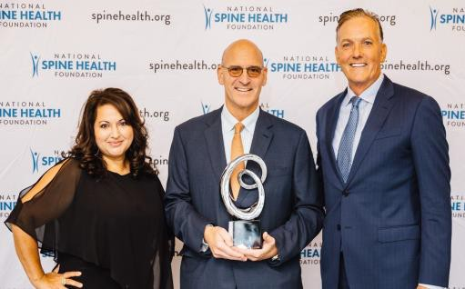
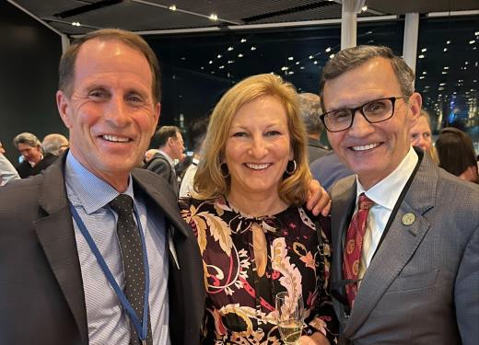
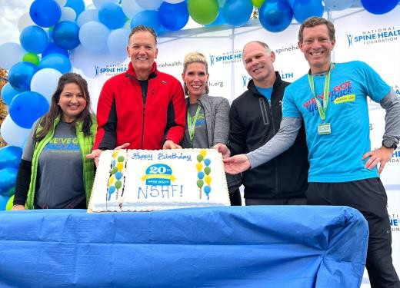
National Spine Health Foundation (NSHF) Overview
Launched 6 years ago, and built on a 15 year research history, NSHF is the only patient-centered non-profit organization dedicated to helping patients overcome debilitating spinal conditions & restore their lives via patient education, advocacy and award-winning research
NSHF helps give patients the tools they need to make informed decisions about their spine health and optimize their own treatment journey with greater confidence
We empower individuals with knowledge and hope, providing meaningful, credible, responsible and authoritative information beneficial in making decisions, along with their health care professional, on the best treatment plan for them

Slide 4
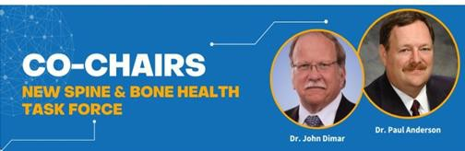

NSHF Spine & Bone Health Task Force
NSHF’s Spine & Bone Health Task Force is focused on steering NSHF’s strategic activities around spine and bone health.
A central focus of our Task Force activities:
spine and bone health patient and health professional education
Improve patient outcomes regarding the diagnosis and treatment of osteoporosis (as it relates to spine surgery)
Name | Institution
Paul Anderson, MD | University of Wisconsin School of Medicine, Madison, WI (Co-Chair)
John Dimar, MD | University of Louisville School of Medicine and Norton Children’s Hospital, Louisville, KY (Co-Chair)
Brandon Carlson, MD | University of Kansas Medical Center, Kansas City, KS
Benjamin Elder, MD, PhD | Mayo Clinic, Rochester, MN
Venu Nemani, MD, PhD | Virginia Mason Franciscan Health, Seattle, WA
Zeeshan Sardar, MD | Columbia Orthopaedics, New York, NY
Ganesh Shankar, MD, PhD | Massachusetts General Hospital, Boston, MA

Slide 5
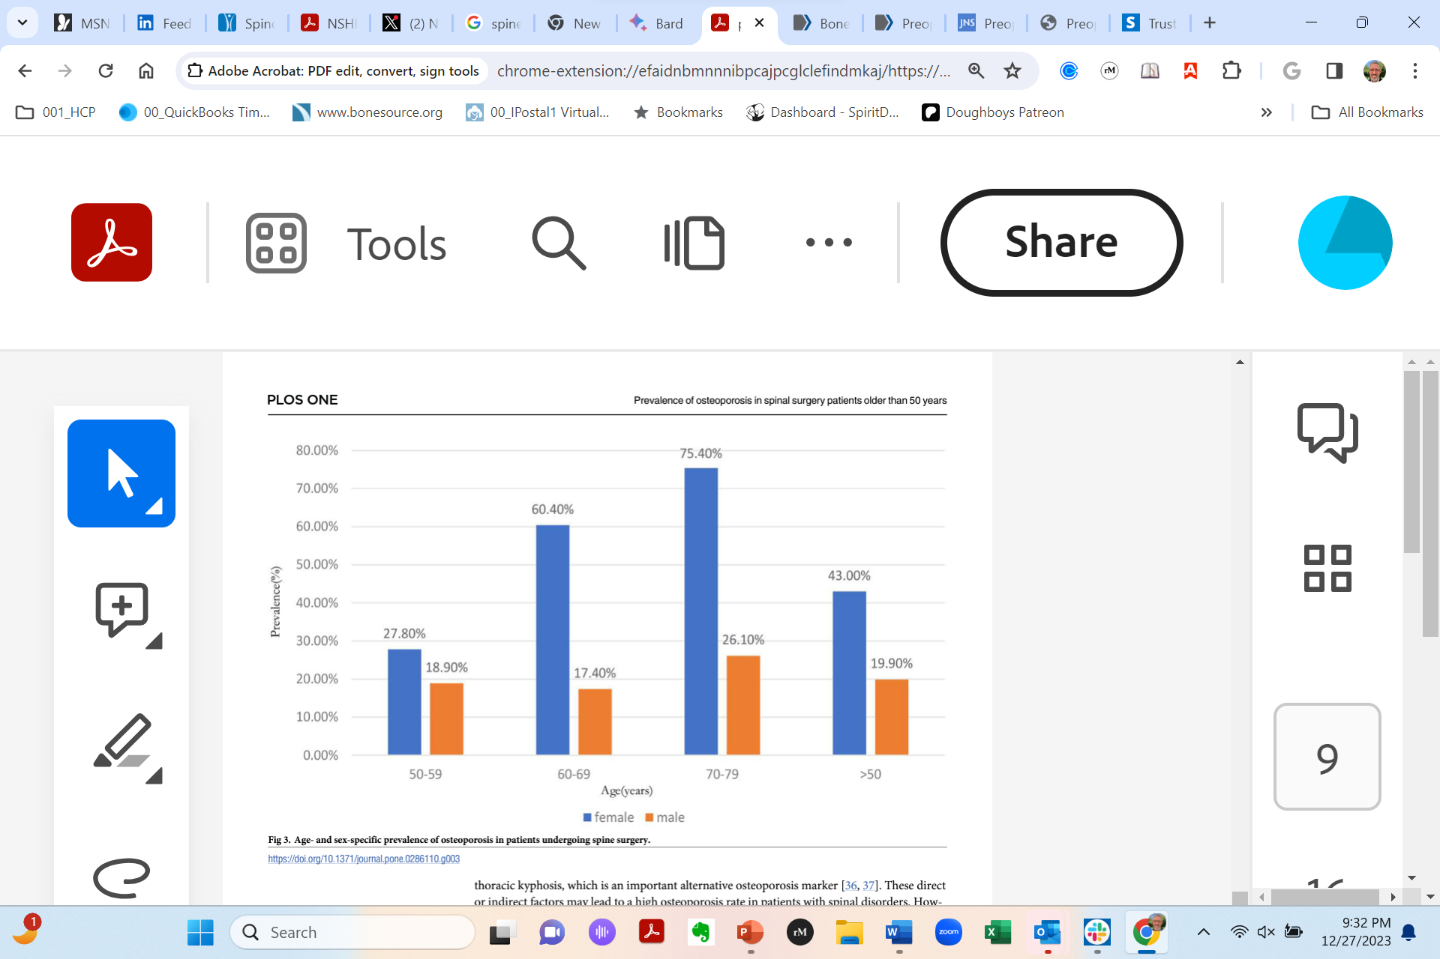
Spine Health Optimization: Connecting Spine and Bone Health for Better Surgical Outcomes
All adult patients undergoing spinal instrumented surgery should have their bone density assessed pre-operatively
Optimizing spine health before surgery is a crucial step for improving patient outcomes and reducing complications
NSHF is educating spine surgeons and non-surgeons to improve bone health and thus increase patient outcomes
Age- and sex-specific prevalence of osteoporosis in patients undergoing spine surgery (per meta-analysis)¹
¹PLoS One. 2023; 18(5): e0286110 (https://www.ncbi.nlm.nih.gov/pmc/articles/PMC10212156/)

Slide 6
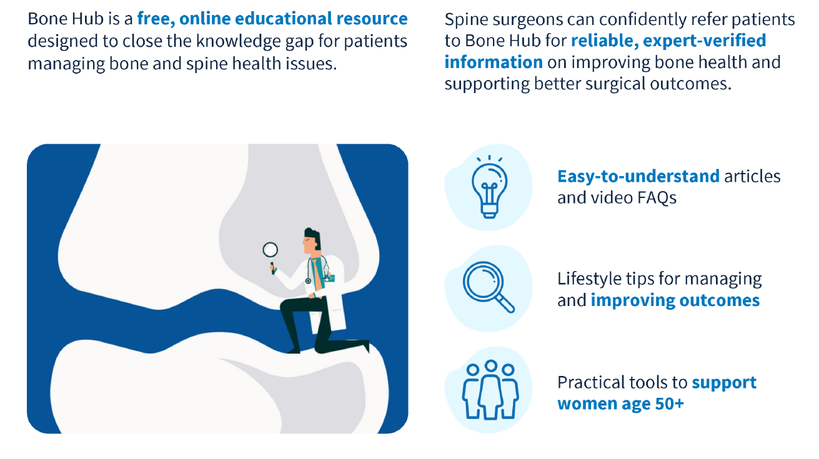
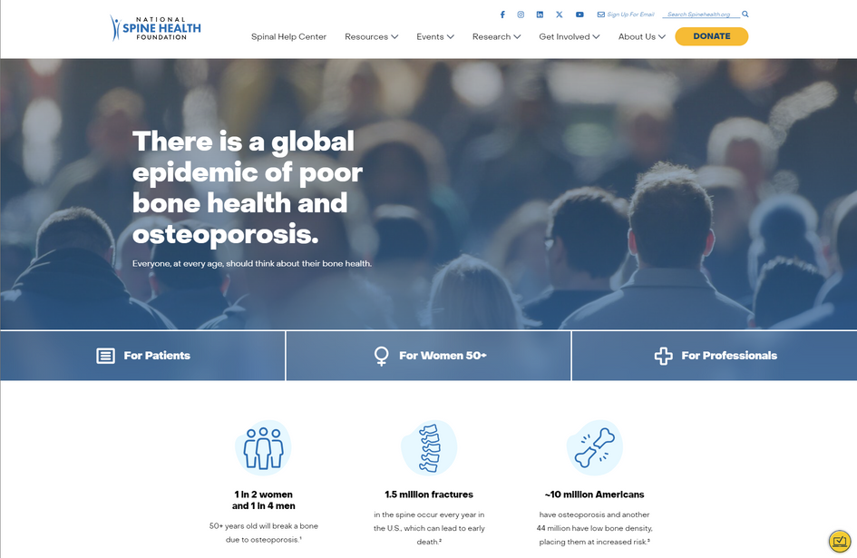
NSHF Bone Hub (Patients/Professionals)
National Spine Health Foundation
Bone Hub
spinehealth.org/bonehub

Slide 7
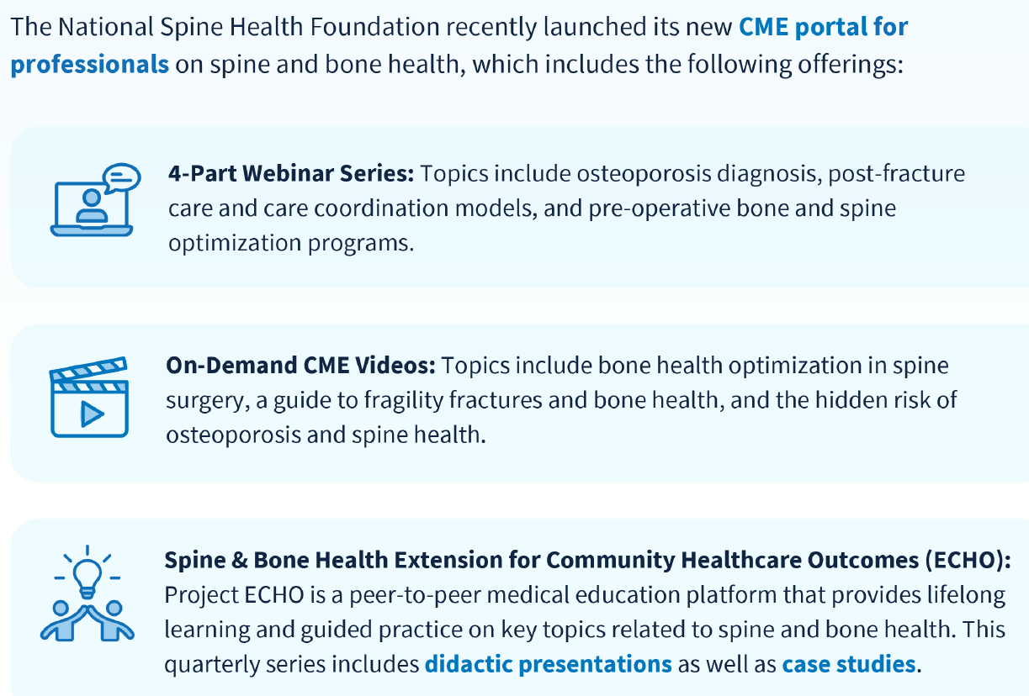
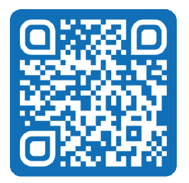
National Spine Health Foundation CME Site
cme.spinehealth.org
This activity is supported by an educational donation provided by Amgen.

Slide 8
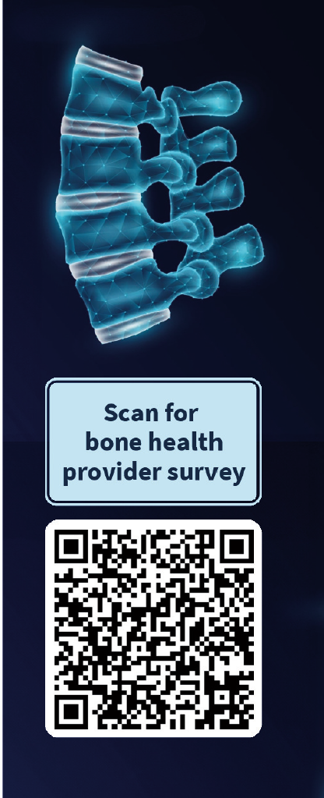
Spine Surgeon Survey
Improving Bone Health Assessment
With rising osteoporosis and increasing spine surgeries assessing bone health before surgery is critical for optimal outcomes.
Survey Purpose
To understand bone health assessment practices and challenges in optimizing care.
This activity is supported by an educational donation provided by Amgen.

Slide 9
Symposium Agenda
Time | Topic/Description | Speaker(s)
7:30-7:35 am | Welcome and Introductions | Rita Roy, MD Chief Executive Officer National Spine Health Foundation
7:35-7:45 am | Osteoporosis Primer: Understanding Bone Analysis | John Dimar, MD University of Louisville School of Medicine and Norton Children’s Hospital Louisville, KY
7:45-7:55 am | Fracture and Surgical Complications Prevention | Benjamin Elder, MD Mayo Clinic Rochester, MN
7:55-8:05 am | Osteoporosis Care Models for the Spine Surgery Patient | Venu Nemani, MD Virginia Mason Healthcare Seattle WA
8:05-8:15 am | Q&A / Conclusion | All

Slide 10
Osteoporosis Primer:
Understanding Bone Analysis
John R. Dimar II, MD
Leatherman Spine Center
Chief of Pediatrics University Hospital
Clinical Professor of Orthopedic Surgery
University of Louisville
Louisville, Kentucky
Department of
Orthopedic Surgery
Leatherman
Spine Center
University of Louisville

Slide 11
Osteopenia: Definition of Osteoporosis & Osteomalacia
Osteoporosis:
  Osteoporosis is a Bony Condition Defined by a Decrease in Bone Quantity (Density) & Mass of Normally Mineralized Bone Which May Compromises the Mechanical Strength of Bone
    Increased Risk of Bony Fracture
    Vitamin D Deficiency in Adults
    COL1A Gene Based
Osteomalacia:
  Osteomalacia is a Decrease in Bone Quality Secondary to Alteration of the Collagen Substrate Matrix Leading to Poor Ossification & Decreased Bone Strength
Simultaneous Disease:
  Both Conditions May Exist Simultaneously
Alterations of
Calcium, Vitamin D3 & Osteoprogenitor Cells Produce These Conditions

Slide 12
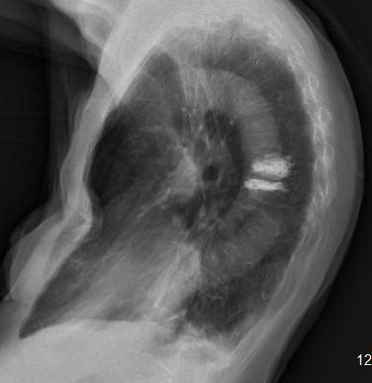
Aging’s Effect on the Spine
In the US:
Introduction
Elderly Are The Most Rapid Growing Segment of The Population
2030: 1 in 5 Individuals at 65 Year Old
Elderly 70+ Year Old
35.3
30.1
% Growth
13.1
Sternal “Buckling” From Kyphosis & Osteomalacia+
Osteoporosis
7.8
8.3
8.1
2001-2010
2010-2020
2020-2030
Year

Slide 13
Tools for Assessment of Bone Quality
CT/HU: Hounsfield Units
BCT: Biomechanical CT Assessment
qCT: Quantitative CT
TBS: Trabecular Bone Score
VFA: Vertebral Fracture Assessment
VBQ/MRI: Vertebral Bone Quality
CT
DEXA
MRI

Slide 14
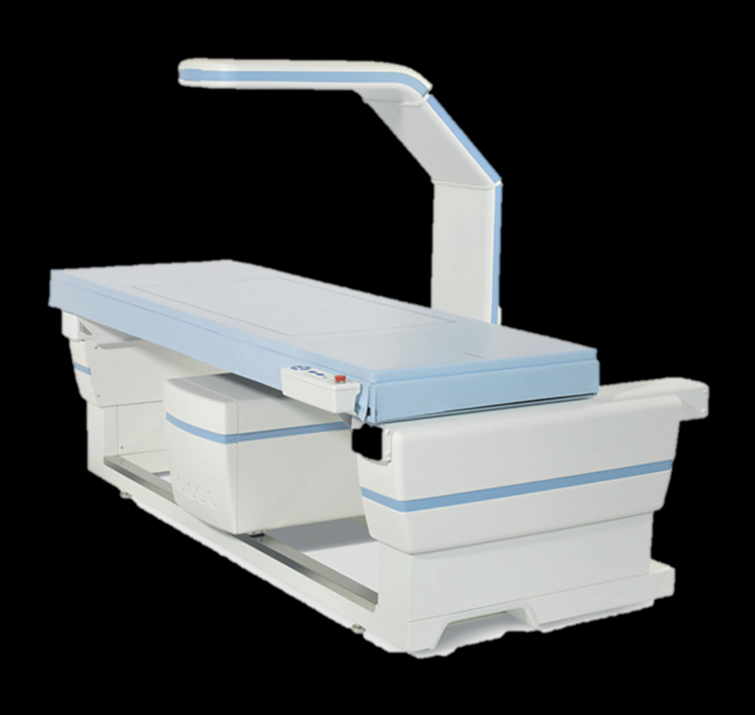
DEXA
DEXA: Dual-Energy X-ray Absorptiometry Scan
Measures Bone Mineral Density (BMD):
  DEXA is the Gold Standard BMD Test
  Central & Peripheral Scans
  Fast, High Precision
  Low Radiation (.1-.5mSv)
  Dual Beams (High and Low Energy) Measure
  Difference in Absorption
  Dual Beams Isolates the Bone Density From Soft Tissues
  Bone Density Calculation in (g/cm2)
  T-Score: BMD Compared to a Healthy 30-Year-Old Adult
  Z-Score: BMD Compared to Age Matched Peers (Used in Children & Young Adults)
DEXA

Slide 15
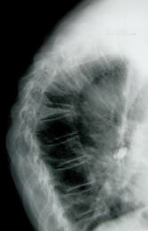
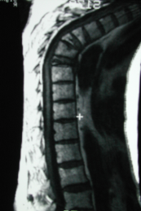
DEXA Scanning- Gold Standard Test
Decreased Bone Density = Fracture = Deformity
+1
Normal
0
-1
T Score -2.5
Z Score -0.5
-2
-3
-4
Avoid Elective ASD Surgery When T Score < -2.5
20
30
40
50
60
70
80
90
100
AGE

Slide 16
TBS - 50% of Fractures Occur in People
Whose BMP T-Score is Better Than -2.5
TBS:
  Evaluates the Trabecular Microarchitecture
  TBS Derived From DEXA, Textured Index of Trab. Bone
  Textural Analysis of Gray-Level Variation in Pixels
  TBS is Independently Associated with Fracture Risk
  TBS Reference Values Included in Software Program
  TBS Values Increase with Age in Children
Osteoporosis is Defined as Low Bone Mass
  Deterioration of Microarchitecture
  Increases Bone Fragility
  Bone More Susceptible to Fracture

Slide 17
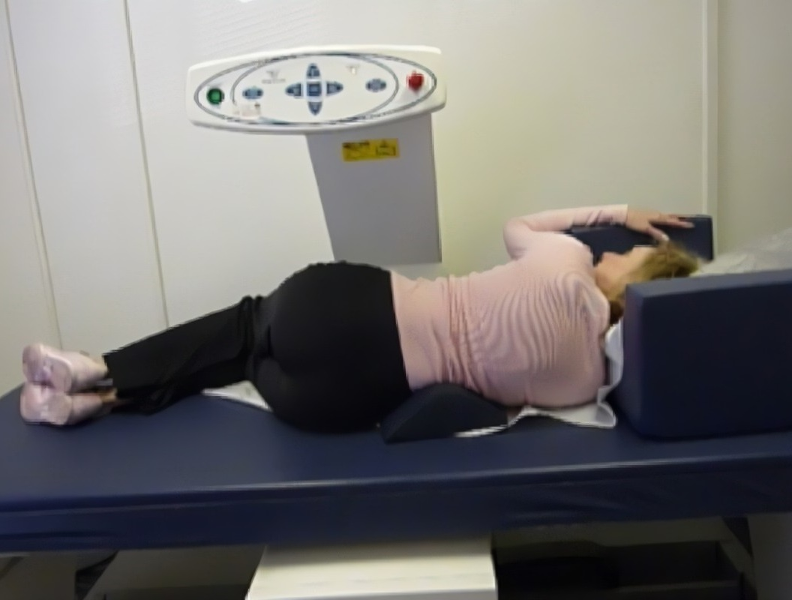
VFA
Genant HK, Vertebral Fractures in Osteoporosis: A New Method for Clinical Assessment, Volume 3, Issue 3, Autun, 2000, Pages 281-290
Identifies Vertebral Fractures Using Low-Intensity Single or Dual-Energy X-rays on Central Densitometers (DEXA Lateral Position)
Identifies Existing Vertebral Fractures Concurrently with DEXA Scan Providing an Estimate of Fracture Risk Beyond That of Just a BMD
Vertebral Fracture Assessment Using a Semiquantitative Technique,
1993 by Genant et al

Slide 18
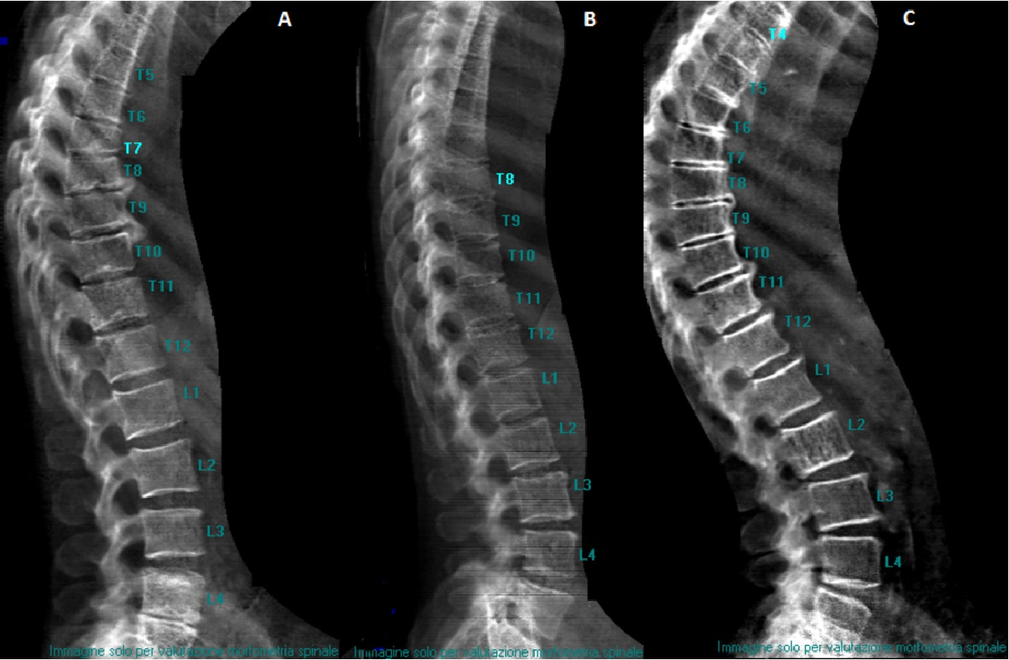
VFA - Vertebra Fracture Assessment
Densitometric VFA is an Image of the Thoracic & Lumbar Spine
Obtained on DEXA Scanners to Diagnose Osteoporotic Vertebral Fractures.
Benefits:
Reduced Parallax
Lower Radiation Dose
Performed Concurrently with DXA BMD
Limitations:
Lower Image Resolution Vs. Regular Spinal XRs
Lower Accuracy to Dx. Mild Fractures
Interpretation:
VFA has Good Sensitivity & Excellent specificity Vs. Plain XRs for Moderate
to Severe Vertebral Fractures (>25% Vertebral Height Loss)
If Mild Fractures (<25% Height Loss) Are Suspected, Confirm with Regular XRs

Slide 19
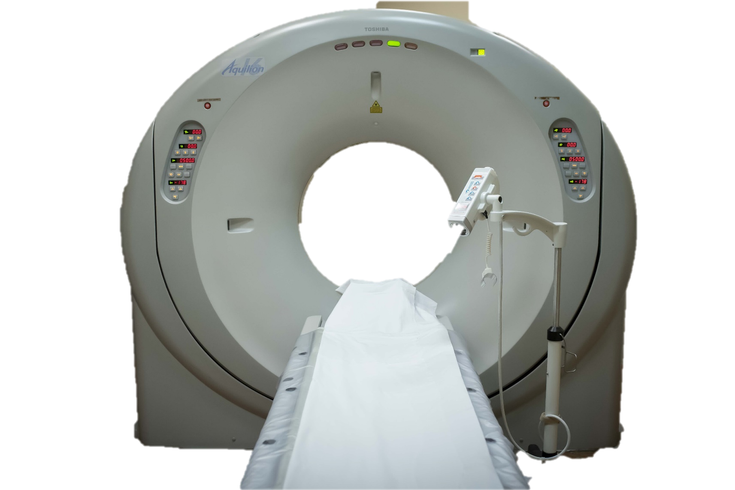
Utilization of Opportunistic CT in Bone Health Assessment
CT Scan
CT Scan
Plain CT Used for Pre-Operative Planning & Optimization
CT Scan Can Assess for Osteoporosis via
HU Measurements of Vertebra
  Low HUs Associate Poor surgical Outcomes
  Identify Occult Fractures
  Fracture Prediction
  Monitor Osteoporosis Treatment

Slide 20
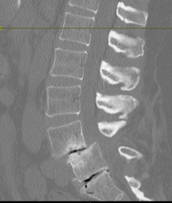
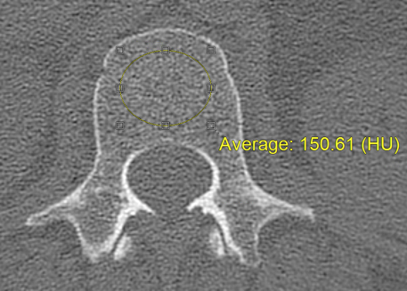
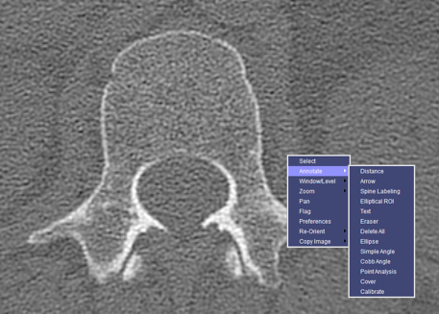
How Do You Measure Hounsfield Units?
PACS
Picture Archiving & Communication System (PACS)
Place Axial & Sagittal Views
Annotate – Elliptical ROI (Region of Interest)
Draw ROI on Axial and/or Sagittal Views
    HU Value Will Automatically Calculate
    Axial Values Considered More Accurate

Slide 21
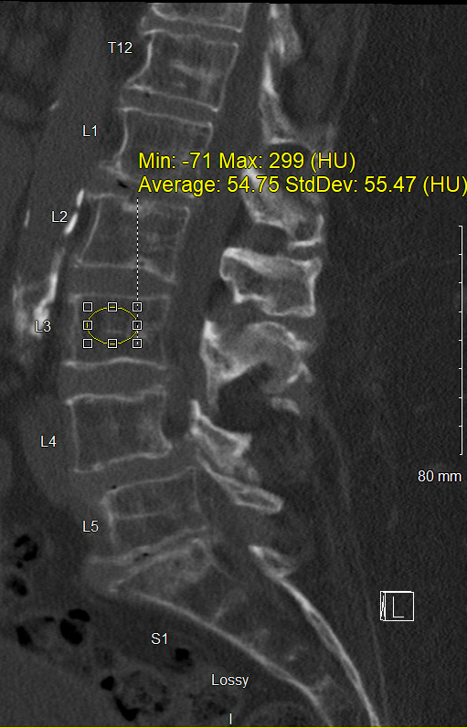
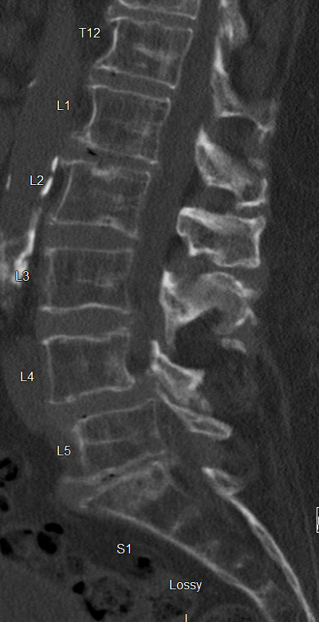
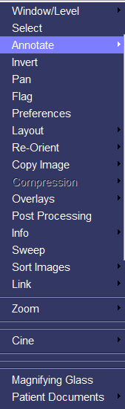
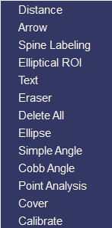
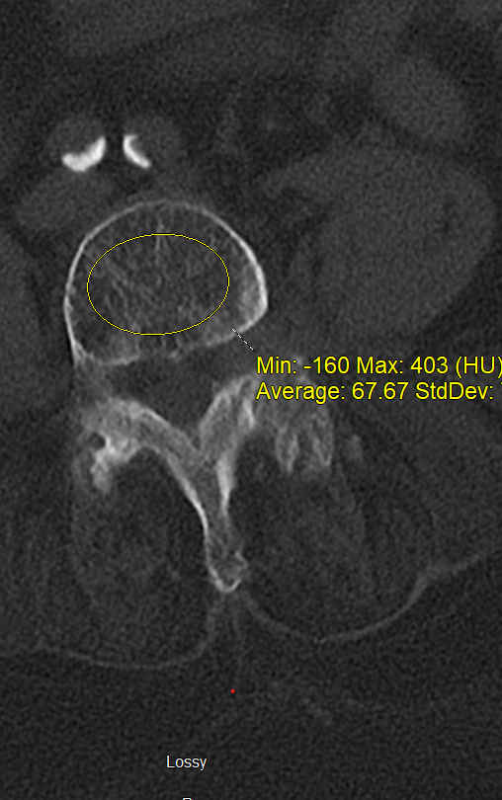
Technique to Measure Hounsfield Units
Sagittal Measurement
Axial Measurement

Slide 22
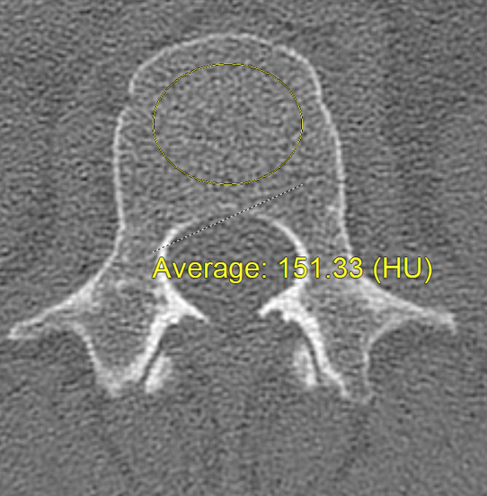
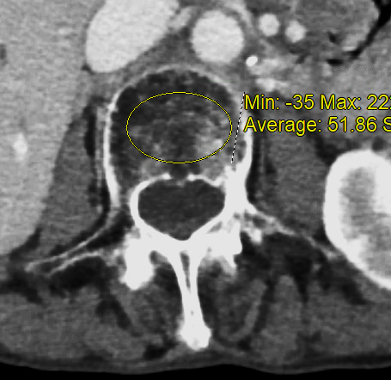
Hounsfield Unit (HU)
Attenuation Coefficient of Each Voxel
  Normalized = 0 for H₂O
  -1000 for Air @STP
Obtained From All CTs
Any Region of Interest (ROI)
Proportional to Tissue Density
  Quantity of Atoms
  Cube of Atomic Mass
HU – Estimate Bone Density
vBMD Calculated from HU

Slide 23
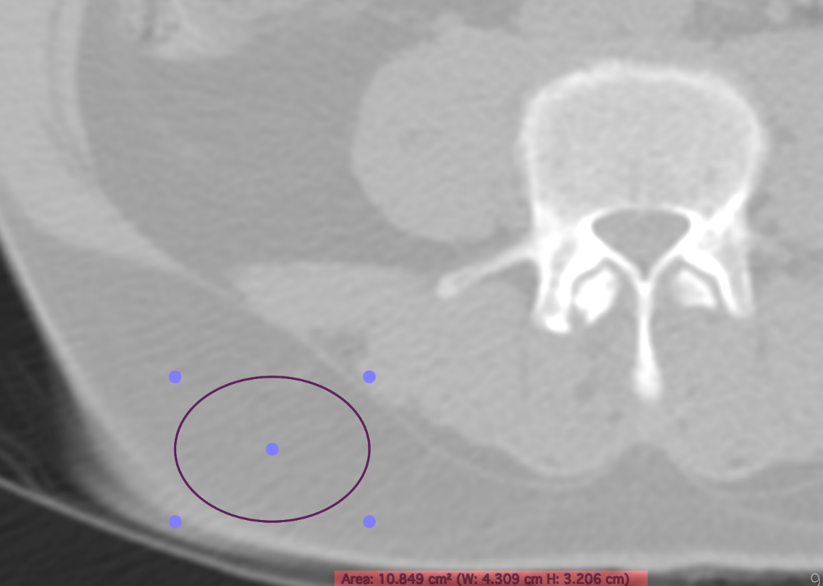
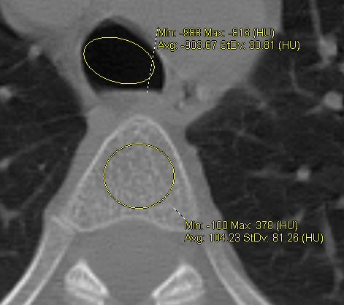
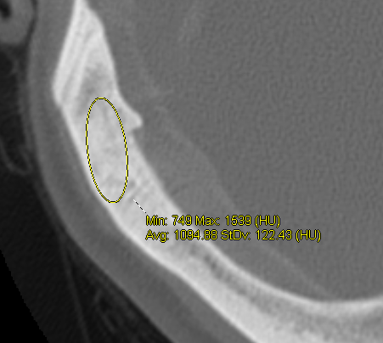
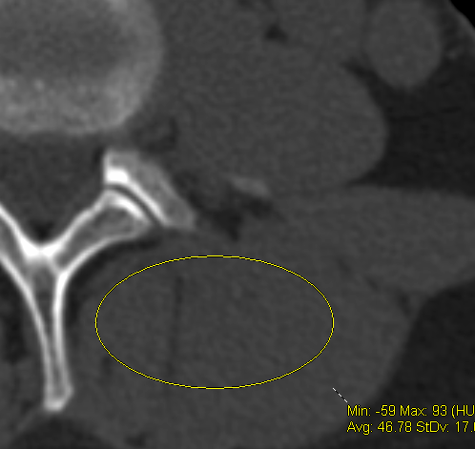
Hounsfield Unit (HU)
Fat - 89
Air - 908
Cancellous - 106
Cortical Bone -1095
Muscle - 46

Slide 24
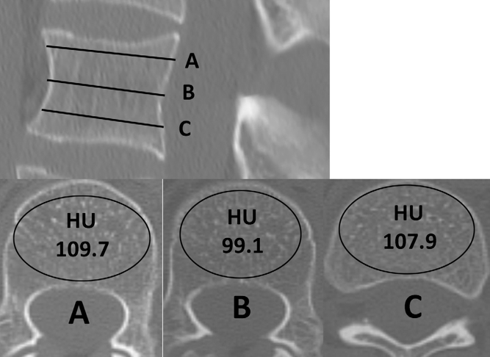
HU Rater Reliability
Intra-rater/ Inter-rater
  Intraclass Correlation Coefficients
Excellent ICC > 0.95
Sensitive to Location of ROI
Excellent Reliability

Slide 25
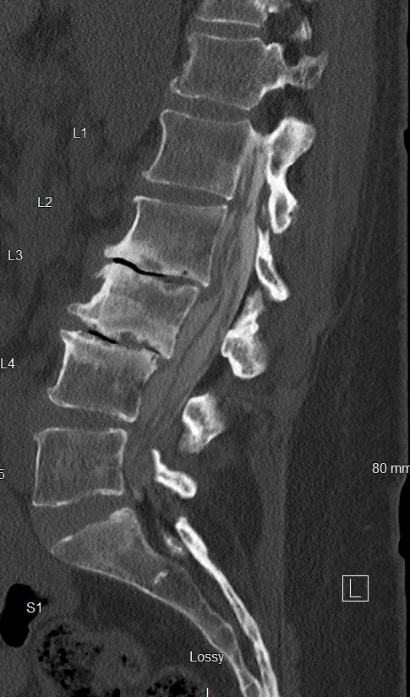
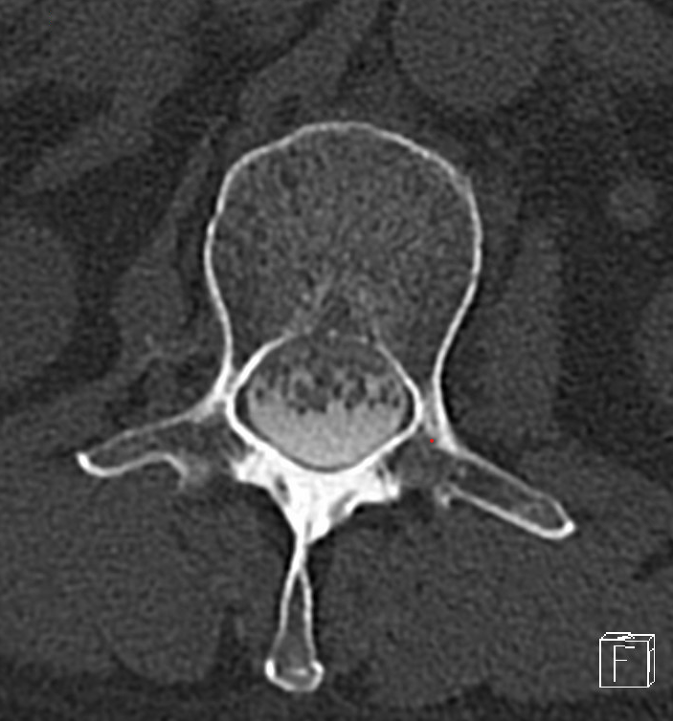
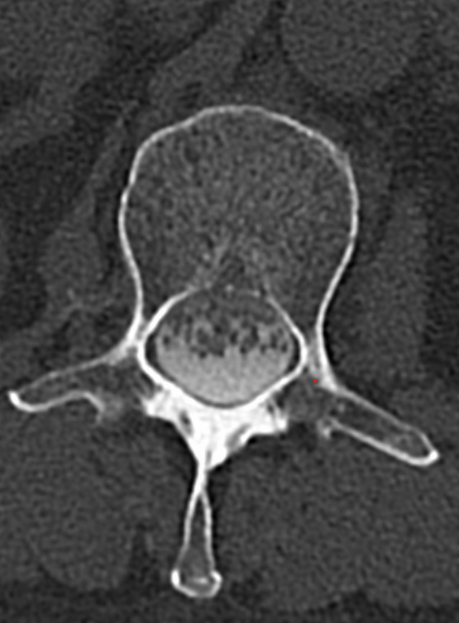
Placement Centroid Vertebral Body
XR Mark-Up
Question: Does Myelographic Dye Effect CT HU Values??

Slide 26
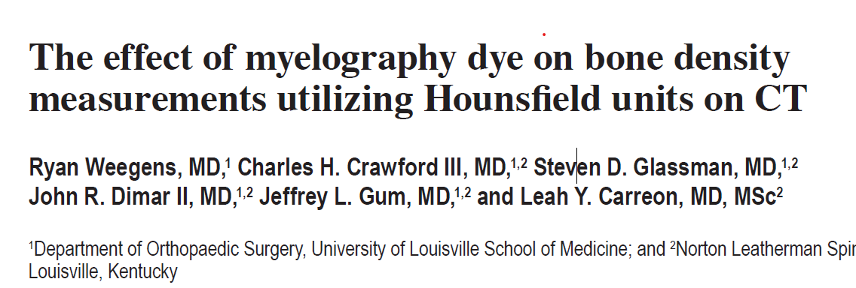
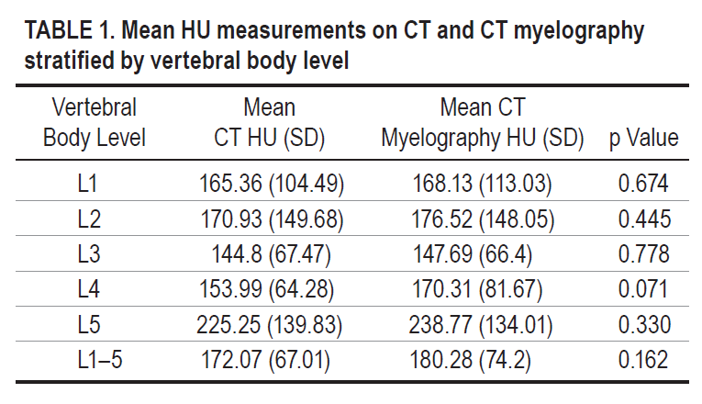
J Neurosurg Spine 40: 513-518, 2024
. The Purpose of the Current Study Was to Determine if the Presence of Myelography Dye Affects HU Measurements of Bone Density in CT Studies.
HU measurement using
the elliptical ROI tool on
the imaging software.
Methods:
  29 Patients
  Had Both Lumbar CTs & Myelo/CTs
  6 Months Apart
  Measured on Both With Axial Centroid
  HUs Were Measured and Compared
Controversial
Myelography Dye DID NOT Significant Effect HU
Measurements on CT in This Study

Slide 27
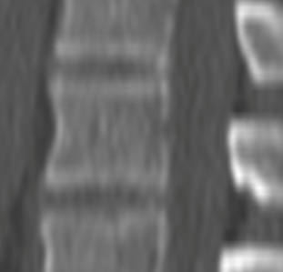
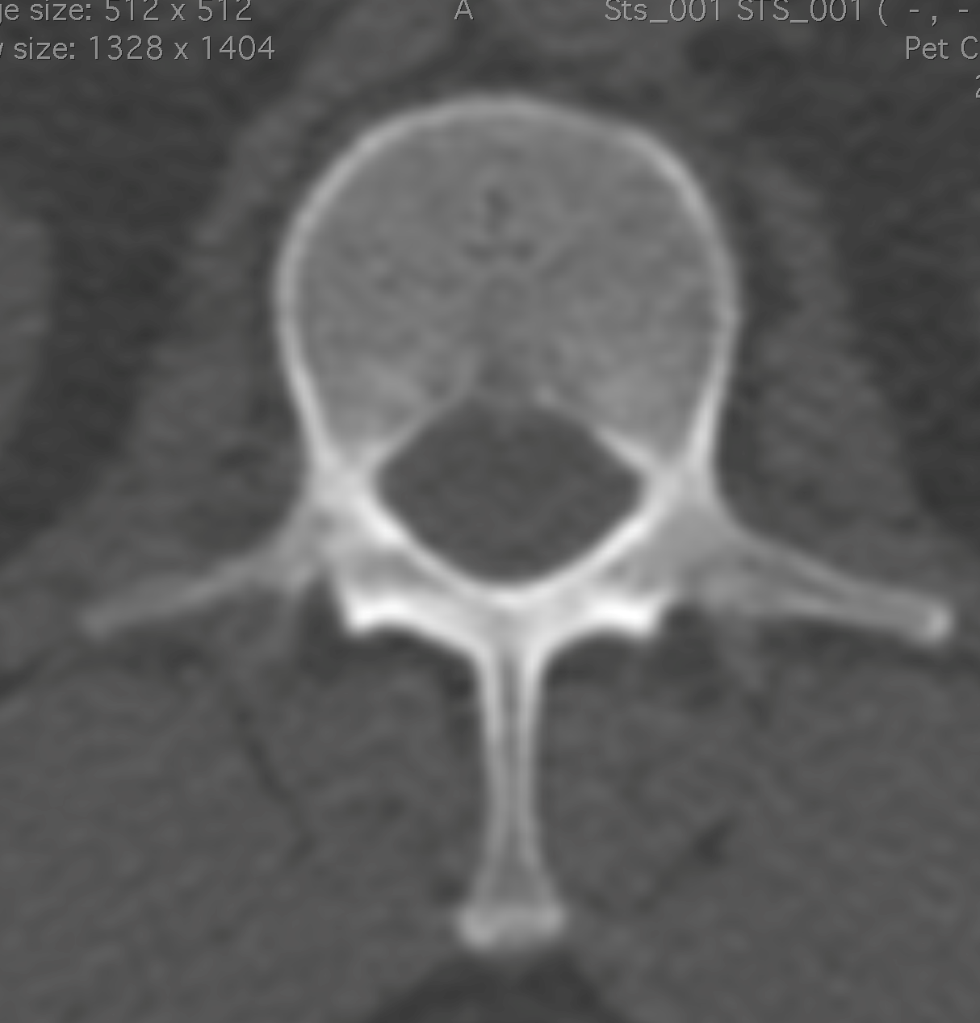
Region of Interest: HUs Different on Sagittal vs Axial Images
Circular 200 mm²
Centroid
  Axial (Higher)
  Sagittal (Lower)
142
128
Significant Difference
Axial > Sagittal (5-10%)

Slide 28
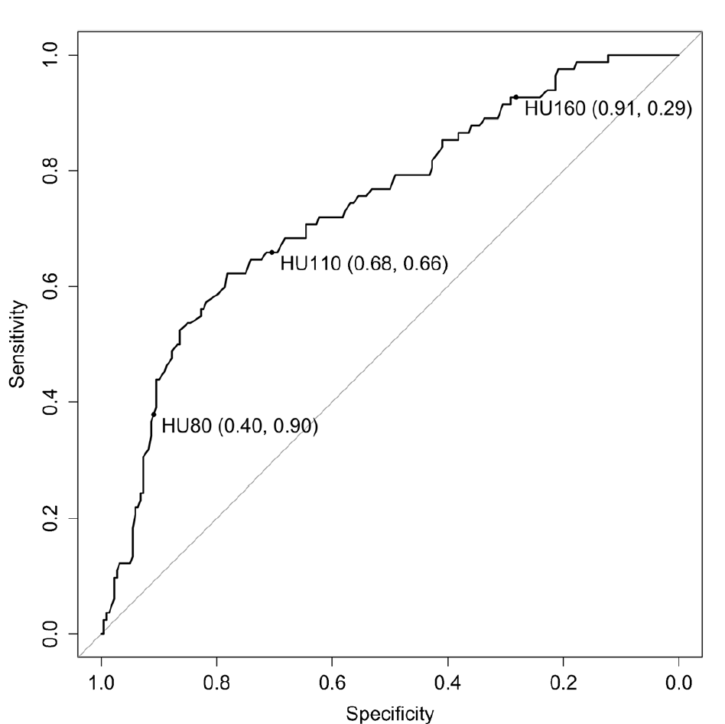
Threshold Osteoporosis (HU-score)
ROC analysis
  AUC > 0.8
 | Osteoporosis Hi-Specificity | Osteopenia Optimized | Normal Hi-Sensitivity
L1 HU | 100 -110 | 135-150 | > 150-160
< 110 Osteoporosis
110-150 Osteopenia
> 150 Normal
Pickhard JBMR 2011
Lee Clin Rev Bone Min metab 2018
Alacreu OI 2017
Buchens EuRad 2015

Slide 29
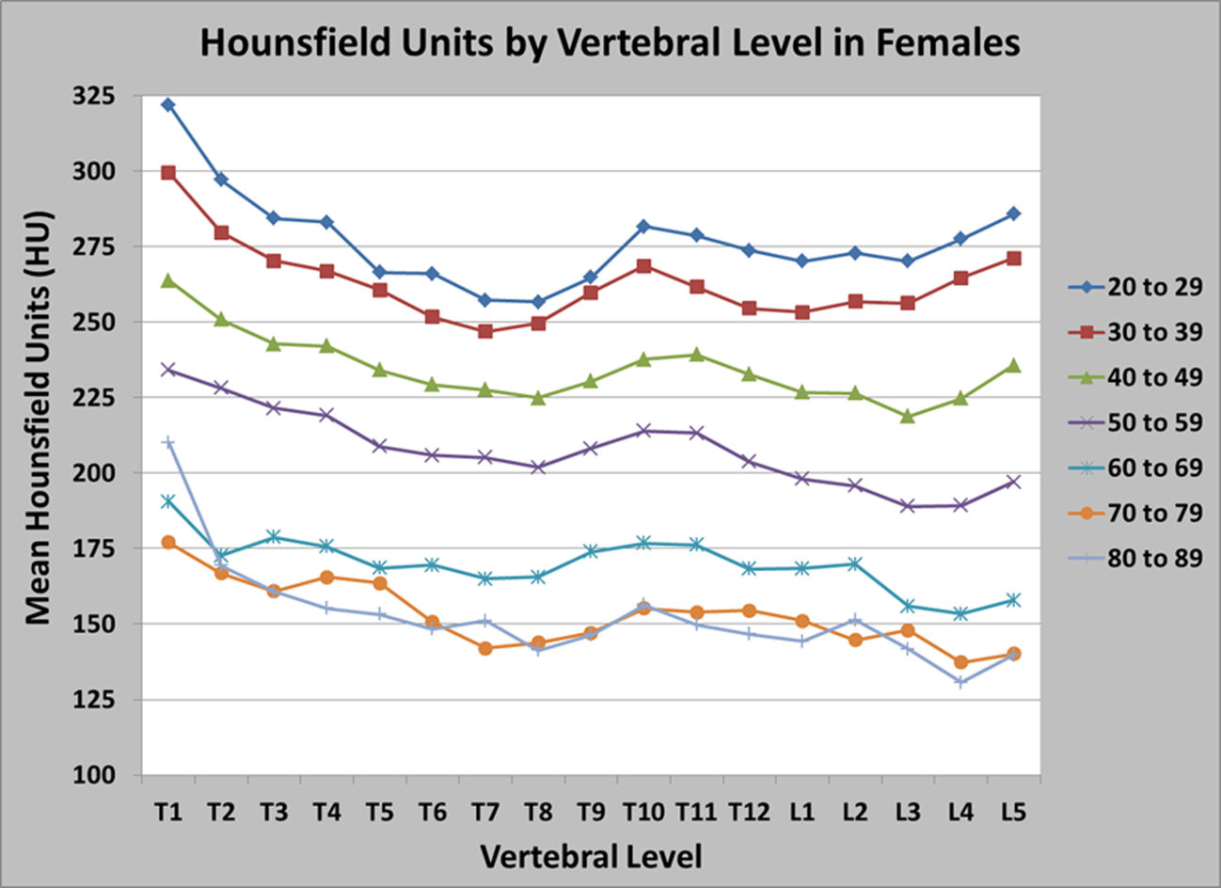
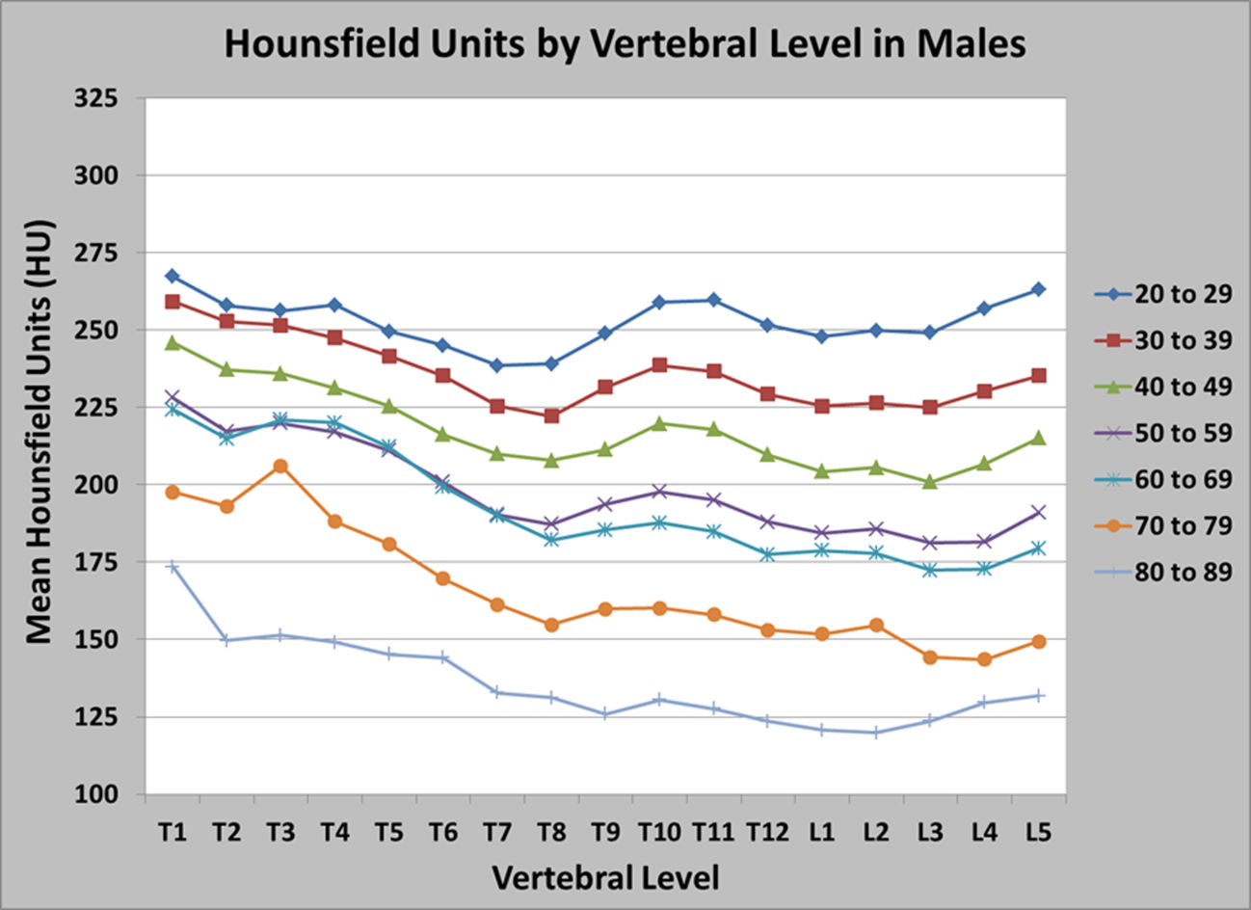
Adults
Normative Vertebral Hounsfield Unit Values and
Correlation with Bone Mineral Density
Aged Averaged HU - Per Level /Sex
Patel SP, Lee JJ, Hecht GG, et.al.
Journal of Clinical & Experimental Orthopaedics, Vol.2 No.1:14, 2016
Mean & 95% Confidence in Normal, Osteopenia, & Osteoporotic Patients |  | Equivalent CT-Hounsfield Units
 |  | DEXA Automated Reports |  | DEXA Radiology Reports
Classification | T - Score | Mean ± SD | 95% CI | Mean ± SD | 95% CI
Normal | Greater than -1.0 | 195.7± 55.5 | 171-220 | 189±59 | 160-219
Osteopenia | Between -1.0 & -2.5 | 118.9 ± 29.1 | 99-139 | 149±49 | 109-170
Osteoporosis | Less than -2.5 | 97.9 ± 58.8 | 54-142 | 107±60 | 65-149
Notes: Values of P , 0.001 Between Automatic Groups & P < 0.01 Between Radiology Groups. DEXA, Dual X-ray Absorptiometry
Adult Key Levels of Interest:
  HU < 135: Osteoporosis
  HU < 50: Surgery Should Be Avoided

Slide 30
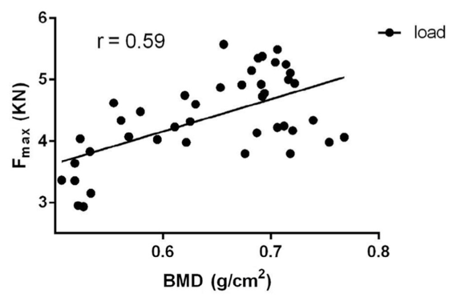
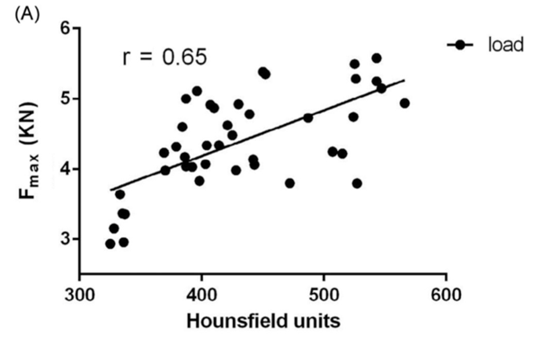
Correlation to Bone Strength
BMD
Lumbar Vertebrae
Correlated Compressive Strength
  DXA
  Hounsfield Units
HU
No Difference Between DXA & HU
Mi, J Clin Den 2016

Slide 31
Normative Bone Mineral Density Measured on
CT scan in Children and Adolescents
Nagata K, Dimar JR, Schmidt GO, Brown M, Daniels C, Glassman SD, Carreon LY
Spine 2024 Feb 1;49(3):214-219
Spine surgeons use Hounsfield Units (HU) on spine CT as a measure of bone mineral density (BMD) before adult spine surgery.
No data
0 to 10

Slide 32
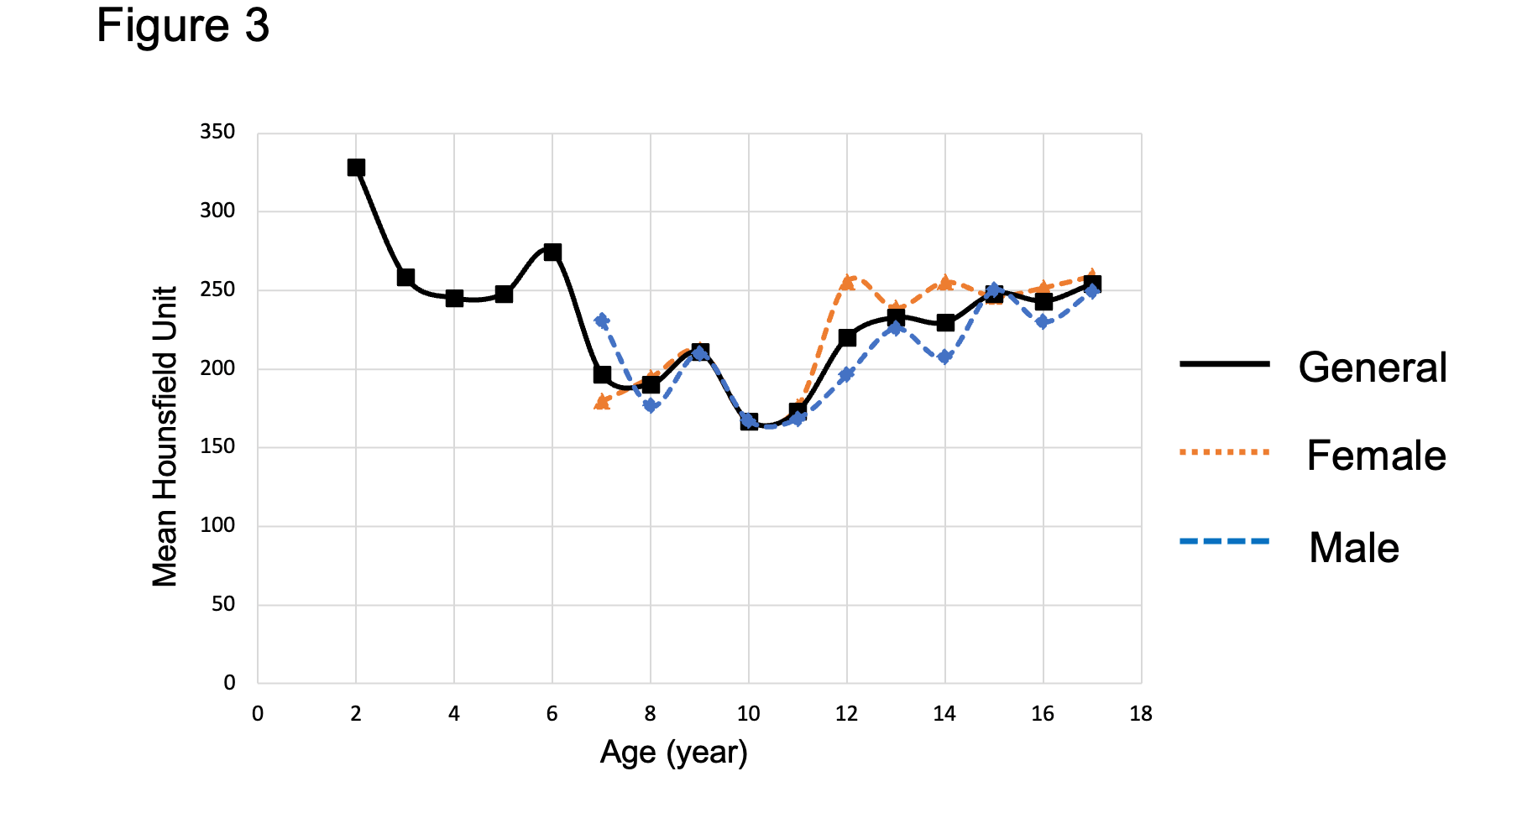
HUs Measurement in Children From Age 3 to 18

Slide 33
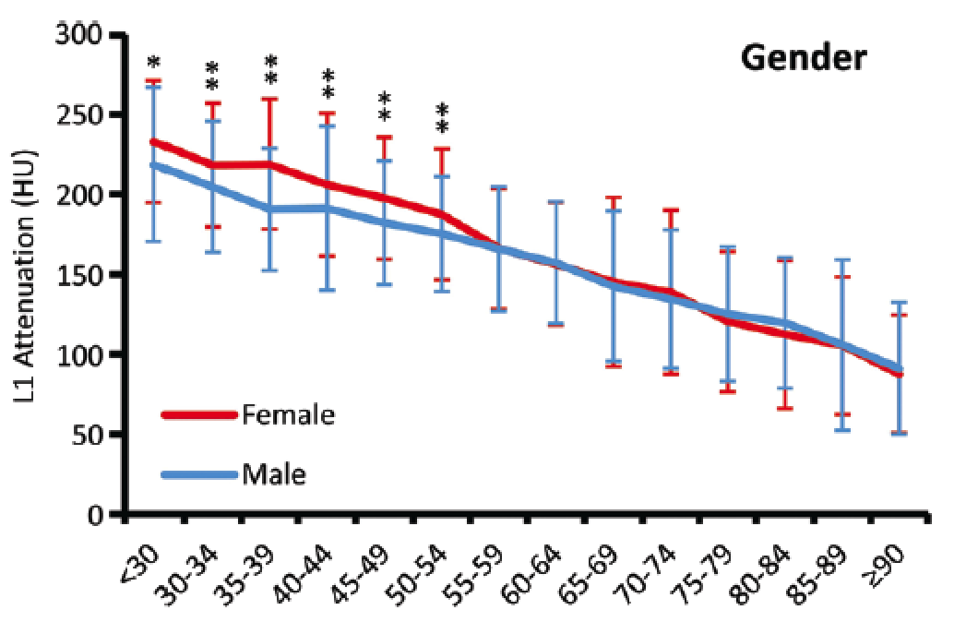
Age Related Changes in HU
20,000 patients
Automated ROI/ HU
Linear Decrease with Age
Women Decreasing Faster Rate After Age 50
Jang Radiology 2019

Slide 34
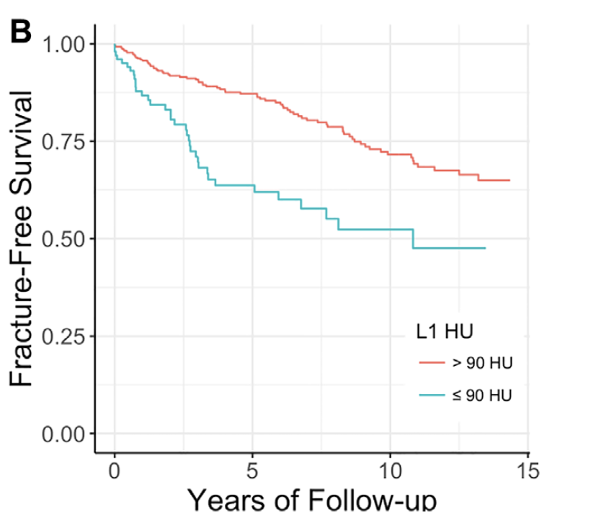
Prediction of Vertebral Fracture
A Few Caveats
509 Body CTs
  Age > 65
F/U 5 Years
22.5% Developed Fracture
Several Thresholds
  HU < 90 Spine Fracture
  HU < 97 Hip Fracture
Lee JBMR 2018

Slide 35
Hounsfield Units Predicting Bone-Related Complications
A Few Caveats
140 Patients Lumbar Fusion
Osteoporotic Related
Complications
Hounsfield Units < 110
Same as for Osteoporosis Threshold
St Jeor. Glob Spine J 2022

Slide 36
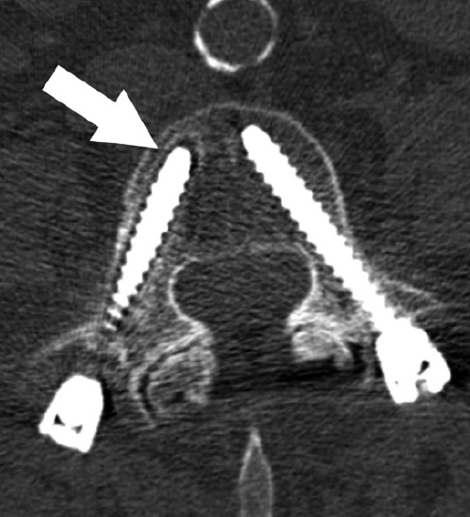
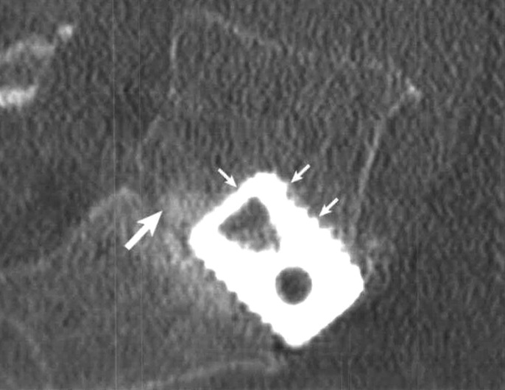
Hounsfield Units Predicting Complications
A Few Caveats
dc
 | Studies | Threshold
Pedicle Screw Loosening | 7 | 110
Cage Subsidence | 3 | 120
Sagittal Imbalance | 1 | 100
Proximal Junction Kyphosis | 6 | 120
Pseudoarthrosis | 1 | 107
Secondary Fracture | 1 | 110

Slide 37
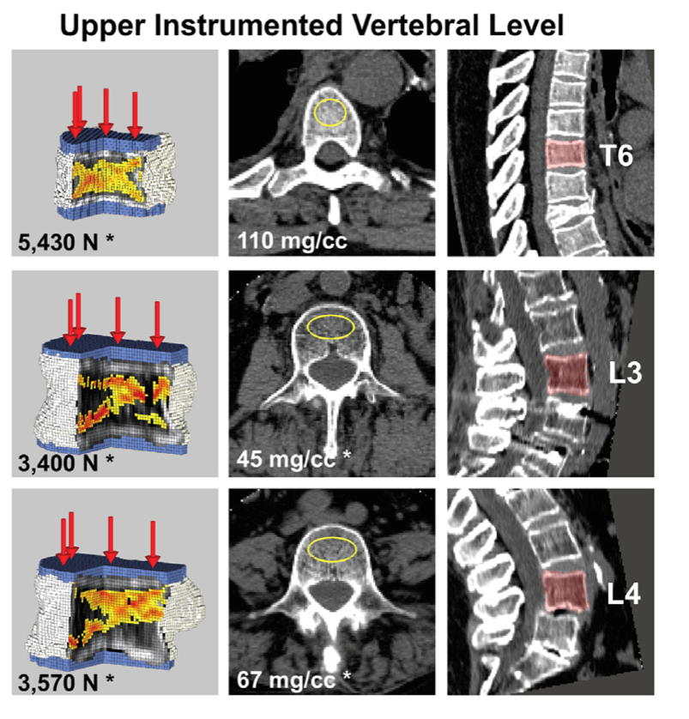
BCT: Biomechanical CT Assessment of the Spine
CT Based Finite Element (FEA) Modeling
Predicts Fx
  4500 N women
  6,000 N for men
469 Fusion Patients
44 Mo. Follow-up
Hazard Ratios 3-4.7
BCT alternate to DXA
Keaveny TM, BL Clarke BL, Cosman Biomechanical Computed Tomography analysis (BCT)
for clinical assessment of osteoporosis, Osteopor Int., 2020 Apr 26; 31 (6): 1025-1048

Slide 38




Biomechanical Computed Tomography (BCT)
CT Scan Measures Both Bone Strength & Bone BMD of the Hip or Spine
Equal to DXA for Diagnosing Osteoporosis & Assessing Fracture Risk
BCT is “An Opportunistic” Calculation From the Existing CT Scan (Hip & Spine)
The Correlation Between BCT and DXA Was Similar (Center), The Correlation Between Left & Right Hip for DXA Was Similar (Bottom) & Over 2X Higher Than Between Hip & Spine for DXA (Top).
Keaveny TM, BL Clarke BL, Cosman Biomechanical Computed Tomography analysis (BCT)
for clinical assessment of osteoporosis, Osteopor Int., 2020 Apr 26; 31 (6): 1025-1048

Slide 39

qCT: Quantitative CT
Quantitative Computed Tomography (QCT) Measures Bone Mineral Density (BMD) with Standard CT scanner with a Calibration Standard
to Convert Hounsfield Units (HU) of the CT image to BMD Readings.
QCT Use Solid Phantoms of CaHAP & K2HPO4 For Reference Standards of Bone Placed in a Pad Under the Patient During CT for Calibration.
The CT Converts Hounsfield Units (HU) of the CT Image to BMD
Quantitative CT Scans are Used to Evaluate the BMD of the Lumbar Spine and Hip.
QCT are Low-dose & the Radiation Exposure Is 200-400μSv for a Spine &Typically Substantially Less Exposure Than a Standard CT

Slide 40
Accuracy of Phantomless Calibration of Routine Computed Tomography Scans for Opportunistic Osteoporosis Screening in the Spine Clinic
Solid Phantoms
Not Needed
Cetik RM, Crawford CH 3rd, Glassman SD, Dimar JR 2nd, et.al.
Spine 2024 Jun 26.
A novel, simple method for phantomless calibration of routine preoperative lumbar CT scans is described.
4 different reference tissues were used in combinations of two: subcutaneous adipose (A), erector spinae (ES), psoas (P) and aortic blood (AB)
From L1 to L4, calibrated vBMDs were better correlated with DXA T-scores when compared with uncalibrated HUs
For low BMD screening, the best candidate is calibration with A+ES (Adipose + Erector Spinae) using a threshold of 162 mg/cm3, which has a sensitivity of >90%
 |  | Total Hip T-Score | Femoral Neck T-Score | Total Lumbar T-Score
L1 | HU (Axial) | .466* | .411* | .487*
 | HU (Sagittal) | .522* | .514* | .523*
 | vBMD by A+ES | .485* | .382* | .671*
 | vBMD by A+P | .375* | .316 | .527*
 | vBMD by A+AB | .507* | .418* | .492*
L2 | HU (Axial) | .584* | .530* | .574*
 | HU (Sagittal) | .604* | .541* | .614*
 | vBMD by A+ES | .553* | .475* | .711*
 | vBMD by A+P | .640* | .601* | .691*
 | vBMD by A+AB | .745* | .681* | .690*
L3 | HU (Axial) | .524* | .447* | .473*
 | HU (Sagittal) | .681* | .620* | .613*
 | vBMD by A+ES | .505* | .339 | .576*
 | vBMD by A+P | .586* | .505* | .579*
 | vBMD by A+AB | .667* | .585* | .585*
L4 | HU (Axial) | .317 | .306 | .378
 | HU (Sagittal) | .370 | .346 | .393
 | vBMD by A+ES | .314 | .298 | .458*
 | vBMD by A+P | .391* | .365 | .487*
 | vBMD by A+AB | .710* | .669* | .648*
Overall | vBMD by A+ES | .551* | .454* | .750*
 | vBMD by A+P | .592* | .530* | .677*
 | vBMD by A+AB | .713* | .635* | .656*
The Results of This Retrospective Study Demonstrate That in-Office
Simple Internal Calibration of Lumbar CT Scans is Feasible, Can Be Used to Calculate vBMDs, & This Novel Method May Provide a Basis for Further Research & Clinical Applications.
Table 2. Correlations table.
-Statistically significant correlations are represented with an asterisk (*). A novel, simple method for
phantomless calibration of routine preoperative lumbar CT scans is described.
-Correlation coefficients greater than 0.6 are presented with a gray background color.
-Abbreviations: vBMD, volumetric bone mineral density; HU, Hounsfield unit; A, adipose tissue; ES,
erector spinae muscle; P, psoas muscle; AB, aortic blood.

Slide 41
MRI - VBQ
Vertebra Bone Quality (VBQ)
  Based on Evidence That Osteoporotic Bone Has Increased Fat Infiltration That Increases T1
  Correlates with DEXA T-Scores
  BMFF (Bone Marrow Fractional Estimate)
  Requires Additional MRI Sequences
  Longer Scans
  BMFF Correlates with QCT and DEXA Scores

Slide 42

Opportunistic MRI
VBQ:
T1 Weighted Sequence
Fat sensitive (Increase Signal Intensity (SI))
Bone Low Signal Intensity
↑ Fat
↑ Signal intensity
Osteoporosis
↓ Bone

Slide 43




Chen Z, Fei L, Fei Y, et. al.,
Journal of Orthopedic Surgery & Research, (2023) 18: 257
Vertebral Bone Quality (VBQ) Score is a MRI Based Trabecular Scoring Method
VBQ Measures Fatty Infiltration on Non-contrast T1-Weighted Images
No Need for Additional Equipment & Software, and Simple
HU= Sensitivity = 80.4%, Specificity 88.9%
VBQ= Sensitivity = 93%, Specificity=65.4%

Slide 44


Vertebral Bone Quality (VBQ)
Ratio SI Body/ CSF
VBQ = 4.82
T-score -3.2

Slide 45
Thanks
On To Fracture & Surgical Complications Prevention

Slide 46
Symposium Agenda
Time | Topic/Description | Speaker(s)
7:30-7:35 am | Welcome and Introductions | Rita Roy, MD Chief Executive Officer National Spine Health Foundation
7:35-7:45 am | Osteoporosis Primer: Understanding Bone Analysis | John Dimar, MD University of Louisville School of Medicine and Norton Children’s Hospital Louisville, KY
7:45-7:55 am | Fracture and Surgical Complications Prevention | Benjamin Elder, MD Mayo Clinic Rochester, MN
7:55-8:05 am | Osteoporosis Care Models for the Spine Surgery Patient | Venu Nemani, MD Virginia Mason Healthcare Seattle WA
8:05-8:15 am | Q&A / Conclusion | All

Slide 47


Fracture and Surgical Complications Prevention
Benjamin D. Elder, MD, PhD
Professor of Neurosurgery, Orthopedics and Biomedical Engineering
Mayo Clinic
Rochester, Minnesota

Slide 48
Disclosures
NIH R01 AR75037
NIH R01 AR78389
NIH R01 AR56212
NIH R01 NS122764
Consultant-SI Bone, Depuy Synthes, Iota Biosciences
Royalty Agreement-SI Bone
Medical Advisory Board-InjectSense
Stock Ownership-InjectSense
Clinical Trial Funding-Stryker and SI Bone

Slide 49
What is Osteoporosis?
Decreased bone mineral density, bone mass, or the quality or structure of bone that leads to a decrease in bone strength that can increase the risk of fractures*
How do we use this clinically?
NIH consensus definition JAMA 2001

Slide 50
Bone Strength (Fracture Risk)
Bone density
  DXA, qCT
Bone quality
  Microarchitecture
  Collagen structure
  Mineralization
  Bone turnover
Bone geometry
  Smaller bones break easier
  Femoral neck angle/ length
  Sagittal imbalance
Bone Strength
Bone Density
Bone
Quality
Bone Geometry

Slide 51
Measures of Bone Fragility
DXA Derived
areal BMD
T-score
TBS (Trabecular Bone Score)
VFA (Vertebral Fracture Assessment)
FRAX Derived
FRAX alone
FRAX + BMD
FRAX + BMD + TBS
CT Derived
qCT, HRqCT (heel)
Hounsfield Units (HU)
Virtual Stress Test

Slide 52
World Health Organization Definition Osteoporosis
Based on DXA testing
T-scores (#SD from reference standard)
  Young Caucasian female
  Lowest T-score
T-score | Classification
>-1.0 | Normal
-1.0 to -2.5 | Osteopenia
≤ -2.5 | Osteoporosis
≤ -2.5 + Fracture | Severe Osteoporosis
Explain < 50% of fractures
Does not aid treatment decisions

Slide 53

Vertebral Compression Fracture
Genant Semiquantitative Method
Notes:
“Mild anterior wedging of a mid thoracic vertebral body”
Vs.
The Genant semiquantitative method combines a qualitative approach of inspecting the vertebral bodies to decide whether a vertebra is fractured with a quantitative assessment of grade and type of fracture
by a comparison to a chart (Fig. 7) [40]. Fractures are defined as either wedge (a reduction in the anterior to posterior height ratio), biconcave (a reduction of the mid- to posterior vertebral height ratio), or a crush fracture (a reduction of the anterior, mid, and posterior heights compared to that of the vertebrae above or below).Of note, fractures may have a combination of these deformities. The fracture is also graded in severity—grade 1 or mild fracture defined as a reduction in anterior, middle, and/or posterior vertebral height of 20–25%, grade 2, or moderate fracture with a reduction in height of 25–40%, and grade 3, or severe, where vertebral height loss is N40%. As has been described, this is the preferred method of the ISCD for identifying and classification of vertebral fractures. One limitation of this method is that physiologic wedging in the thoracic spine can lead to over-diagnosis of wedge vertebral fractures.

Slide 54
Fracture Risk Approximately Doubles With Every Standard Deviation Decrease
Relative Risk for Fracture
Femur Neck Bone Density T-score
Notes:
Exponential Relationship, no threshold
The T-score “cut-point” of -2.5 for osteoporosis was chosen so that the proportion of females over 50 who have osteoporosis by BMD of the hip, spine, and forearm (about 30%) is approximately the same percentage of Caucasian females over 50 who will have fractures (40%) Kanis JBMR 1994.

Slide 55

Distribution of Fractures & BMD
Siris ES et al. Osteoporos Int. 17(4):565-74, 2006
Notes:
1: Osteoporos Int. 17(4):565-74, 2006

Slide 56

Prevalent Vertebral Fracture & Future Vertebral Fracture Risk
Ross: Ann Intern Med 114:919-923, 1991
Notes:
Only 20%-30% of vertebral fractures are recognized clinically and the rest are discovered incidentally on lateral spine radiographs.

Slide 57


479 patients >50yo were evaluated with DEXA and CT (HU) to determine the rate of osteoporosis in patients undergoing spinal surgery
Overall Rate is approx. 39.7%
Females diagnosed more commonly with DXA (48.9% vs. 27.1%)
Patients with lumbar scoliosis had a higher rate of OP (56.5% vs. 36.8%)
Among 324 patients with no OP by DXA 25.9% had osteoporosis utilizing L1 HU <110

Slide 58


Retrospective review of 244 spine patients from 2 academic centers
Patients had:
DEXA, CT (HU), TBS, FRAX
Osteoporosis determined using 4 criteria:
WHO (T-score < -2.5 (25.4%)
CT HU of < 110 (36.5%)
NBHA guidelines (75%)
  a) T-score ≤ −2.5 or
  b) history of low-energy fracture or
  c) FRAX ≥3% (hip) or ≥20% (MOF) 10-yr fracture risk
Expanded guidelines (NBHA and or HU<110 or degraded TBS in the setting of osteopenia on DEXA) (81.9%)
(Age)
osteoporosis

Slide 59
What is the significance of bone density in spine fusion?

Slide 60



Retrospective review of 143 patients undergoing L3-5 instrumented fusion.
L3 Mid-body and pedicle HU calculated and corelated with L3 Screw loosening

Slide 61




Retrospective review of 503 patients undergoing pedicle screw fixation.
L1-4 HU 106.3 (loosening) vs. 132.6 (non-loosening)

Slide 62


CT Scans obtained in 365 patients with pedicle screw fixation/
45/365 patients-loosening
62/2038 screws-loosening
HU in loosening 116.3
HU in no loosening 132.7

Slide 63


Slide 64


Slide 65
Results
32% of patients had an osteoporotic related complication (ORC)
No significant differences in demographics
Multilevel fusions associated with higher ORCs
Patients with ORCs had lower DXA T-scores (-1.6 vs -1.1), and lower mean HUs (112 vs 148)
Multivariable logistic regression analysis showed only lower HU was independent predictor of an ORC
1.7-fold increase in ORCs for every 25 point decrease in HU

Slide 66


89 TLIF patients retrospectively reviewed for subsidence of the cage postoperatively.
Average L1 HU was an independent predictor of cage subsidence
No Subsidence Subsidence
167.8 ± 14.04 HUs vs 137.71 ± 12.83 HUs, respectively; p = 0.002

Slide 67


Retrospective review of 68 patients undergoing single level LLIF looking at the correlation between cage subsidence and preoperative HU on CT scan.
HU < 135.02 had 15.694 times the likelihood of severe cage subsidence.

Slide 68


Slide 69


Slide 70


Slide 71

Notes:
Odds ratio is per HU, which is a pretty significant odds ratio when you consider how relatively small a single HU is

Slide 72

AUC = 0.89
Optimal Cutoff HU =122
Notes:
Optimal cuttoff that maximizes sensitivity and specificity for HU in predicting PJK or PJF

Slide 73


Slide 74

Notes:
P-values <0.05 are bolded

Slide 75


Slide 76


Slide 77
Conclusions
T-score diagnosis underestimates risk
Utilize clinical osteoporosis
  BMD
  Fracture history
  Fracture risk
Treatment proceeds by risk stratification

Slide 78
Symposium Agenda
Time | Topic/Description | Speaker(s)
7:30-7:35 am | Welcome and Introductions | Rita Roy, MD Chief Executive Officer National Spine Health Foundation
7:35-7:45 am | Osteoporosis Primer: Understanding Bone Analysis | John Dimar, MD University of Louisville School of Medicine and Norton Children’s Hospital Louisville, KY
7:45-7:55 am | Fracture and Surgical Complications Prevention | Benjamin Elder, MD Mayo Clinic Rochester, MN
7:55-8:05 am | Osteoporosis Care Models for the Spine Surgery Patient | Venu Nemani, MD Virginia Mason Healthcare Seattle WA
8:05-8:15 am | Q&A / Conclusion | All

Slide 79



Osteoporosis Care Models for the Spine Surgery Patient
Venu M. Nemani, MD, PhD
Center for Neurosciences and Spine
Virginia Mason Medical Center
Spine Summit 2025
Tampa, FL
February 21, 2025

Slide 80




CASE EXAMPLE
72F who presented to another surgeon with back pain
Original presenting xrays show a minor scoliosis
Underwent a PSF T10-pelvis within 1 month of seeing him for the first time, and noticed an immediate prominence of instrumentation even before hospital discharge
Told by her surgeon that “everything looked fine”

Slide 81
CASE EXAMPLE
Now presents with difficulty standing upright and severe back pain
No myelopathy symptoms and no neurological deficits
Does this patient need an evaluation of her bone health?
If so, how to best initiate this and take her through the optimization process?

Slide 82



BONE HEALTH SCREENING
AND OPTIMIZATION!!

Slide 83


WHO SHOULD BE SCREENED FOR POOR BONE HEALTH?
Bottom Line
- Screen everyone > age 65
- Screen those < age 65 with risk factors (or if you’re suspicious)

Slide 84
CASE EXAMPLE
Clues in this patient:
- Thin (BMI 20)
- Older Caucasian female
DEXA
Femoral neck T-score -2.8
Normal T-score > -1.0
Osteopenia -1.0 > T-score > -2.5
Osteoporosis T-score < -2.5
→ What if her T-score was -2.3??

Slide 85
CASE EXAMPLE
Remember – Osteoporosis Can Be Diagnosed Multiple Other Ways Even if T Score is > -2.5
- FRAX score 10 yr hip fx risk > 3% or MOF risk > 20%
- Low energy (“fragility”) fractures
- Prescence of vertebral compression fractures on lateral xray

Slide 86

Next Step - Bone Health Assessment (History / Labs)
Calcium 1500mg / day
Vit D3 1000 IU / day
Goal 25-OH vit D level > 30 ng/mL
Optimize modifiable risk factors ASAP!!
Nemani et al, manuscript under review

Slide 87

What Next?
Treatment of osteoporosis prior to spine surgery
- improves outcomes
- reduces complications
Options
Refer to endocrinology/PCP
In house bone health program
Bone health optimization program embedded within your department (best)
Treat yourself

Slide 88
PHARMACOLOGICAL TREATMENT
Anti-Resorptives
Bisphosphonates
SERMs
Denosumab
Calcitonin
Anabolics
Teriparatide
Abaloparatide
Romosozumab
Inhibit osteoclast function
Stimulate osteoblast function

Slide 89
PHARMACOLOGICAL TREATMENT
Anabolics should be 1st line (but are expensive, hard to get approved)
Treat at least 3-12 months before surgery and continue postop
Need to “seal in gains” with bisphosphonate after completion of therapy with an anabolic
Sequence of treatment matters (anabolics first, bisphosphonates second)
Choice is often dictated by insurance and medical factors

Slide 90


3 months of preop romosozumab treatment
Revision PSF T4-pelvis, VCR T10, ALL release T9-10, reverse PCO L3-4

Slide 91


Reverse osteotomy (PCO) with fibular strut to maintain kyphotic correction

Slide 92
Preop parameters
PI = 43
L1-S1 lordosis = 65
L4-S1 lordosis = 32
PT = 23
L1PA = -1
T4PA = 2
Postop parameters
PI = 43
L1-S1 lordosis = 55
L4-S1 lordosis = 32
L1PA = 3
T4PA = 1

Slide 93
Summary
Have a high suspicion for bone health problems
Obtain labs and DEXA scans early
Start Ca and vit D supplementation early
Develop key partnerships with bone health specialists / endocrinologists who enjoy treating this patient population or setup an in-house program!

Slide 94
Symposium Agenda
Time | Topic/Description | Speaker(s)
7:30-7:35 am | Welcome and Introductions | Rita Roy, MD Chief Executive Officer National Spine Health Foundation
7:35-7:45 am | Osteoporosis Primer: Understanding Bone Analysis | John Dimar, MD University of Louisville School of Medicine and Norton Children’s Hospital Louisville, KY
7:45-7:55 am | Fracture and Surgical Complications Prevention | Benjamin Elder, MD Mayo Clinic Rochester, MN
7:55-8:05 am | Osteoporosis Care Models for the Spine Surgery Patient | Venu Nemani, MD Virginia Mason Healthcare Seattle WA
8:05-8:15 am | Q&A / Conclusion | All

Slide 95
Contact
Dr. Rita Roy
NSHF Chief Executive Officer
rroy@spinehealth.org
David Lee, MA
NSHF Partnerships and Program Lead, Spine and Bone Health
dlee@spinehealth.org

