Slide 1


Bone Health Optimization in the Spine Patient
Venu M. Nemani, MD, PhD
Center for Neurosciences and Spine
Virginia Mason Medical Center
Seattle, WA USA
Global Spine Congress 2025
Rio de Janeiro, Brazil
We give knowledge.
We give hope.

Slide 2

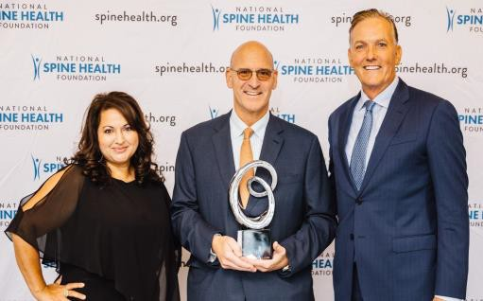
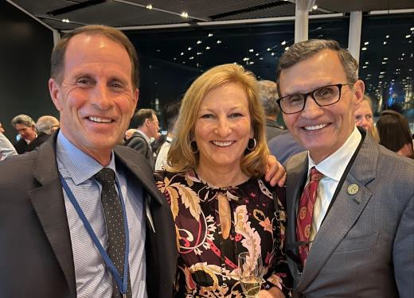
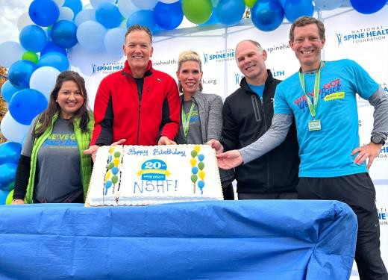
National Spine Health Foundation (NSHF) Overview
Launched 6 years ago, and built on a 15 year research history, NSHF is the only patient-centered non-profit organization dedicated to helping patients overcome debilitating spinal conditions & restore their lives via patient education, advocacy and award-winning research
NSHF helps give patients the tools they need to make informed decisions about their spine health and optimize their own treatment journey with greater confidence
We empower individuals with knowledge and hope, providing meaningful, credible, responsible and authoritative information beneficial in making decisions, along with their health care professional, on the best treatment plan for them

Slide 3






$300 billion annual cost to U.S. economy, with 250 million lost work days each year
#1 job-related disability in the US and around the world
is back and neck pain
#1 reason for opioid prescriptions,
aside from cancer-related conditions
#1 site for osteoporotic fractures is the spine significantly increasing risk of death
#1 reason people see a physician, except for flu/common cold

Slide 4
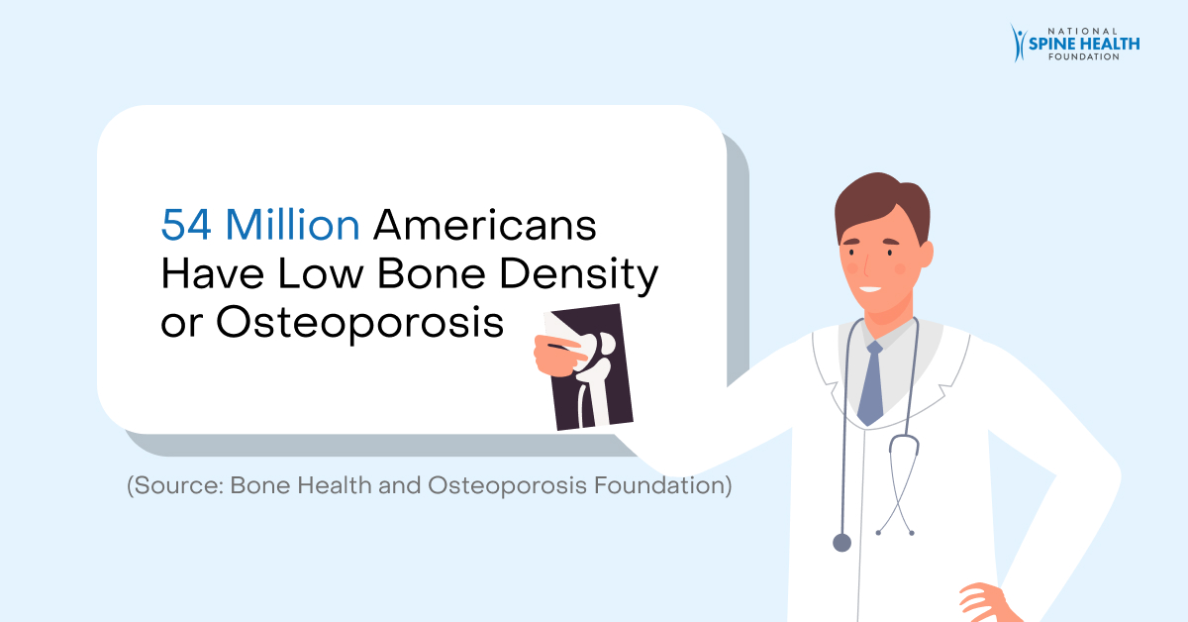
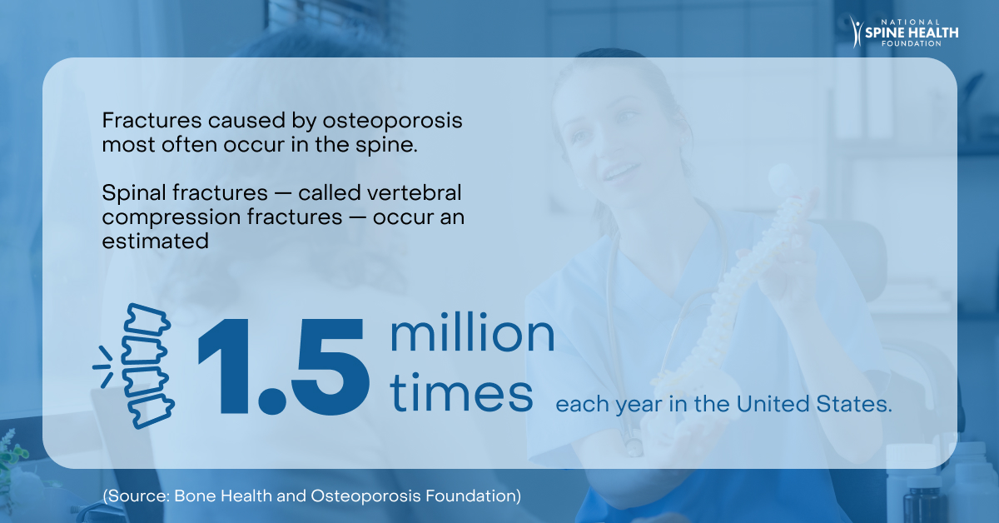
Impact of Spine and Bone Health – United States
2,300,000²
Fragility fractures occurred in 2,000,000 Medicare patients (2015)
9%²
Of female Medicare fee for service beneficiaries received a bone mineral test within 6 months of their fracture (2015)
$25 Billion²
Anticipated annual cost of treating fragility
fractures each year (2025)
²Medicare cost of osteoporotic fractures: The clinical and cost burden of an important consequence of osteoporosis. Milliman Research Report (August 2019).
.

Slide 5
Impact of Spine and Bone Health – Global
Osteoporosis affects 21.2% of women and 6.3% of men over the age of 50 globally
Based on the world population of men and women, 500 million men and women worldwide are affected by osteoporosis¹
70 fractures caused by osteoporosis occur every minute
37 million fractures annually in individuals aged over 55²
1 in 3 women and 1 in 5 men over age 50 will experience a fracture caused by osteoporosis in their lifetime³ ⁴
Only one-third of vertebral fractures come to clinical attention and under-diagnosis of vertebral fracture is a worldwide problem
The proportion of vertebral fractures that go unrecognized are as high as 46% in Latin America, 45% in North America, and 29% in Europe/South Africa/Australia⁵
]
1]
¹Kanis, JA, et al., A reference standard for the description of osteoporosis. Bone 2008. 42: 467-75
²Global Burden Disease Fracture Collaborators. Global, regional, and national burden of bone fractures in 204 countries and territories, 1990-2019: a systematic analysis from the global burden of disease study 2019. Lancet Healthy Longev. 2021; 2(9): e580–e592.
³Melton, L.J., 3rd, et al., Perspective. How many women have osteoporosis? J Bone Miner Res, 1992. 7(9): 1005-10.
⁴Melton, L.J., 3rd, et al., Bone density and fracture risk in men. J Bone Miner Res, 1998. 13(12): 1915-23.
⁵Delmas, PD, et al., Underdiagnosis of vertebral fractures is a worldwide problem: the IMPACT study. J Bone Miner Res, 2005. 20(4): p. 557-63

Slide 6
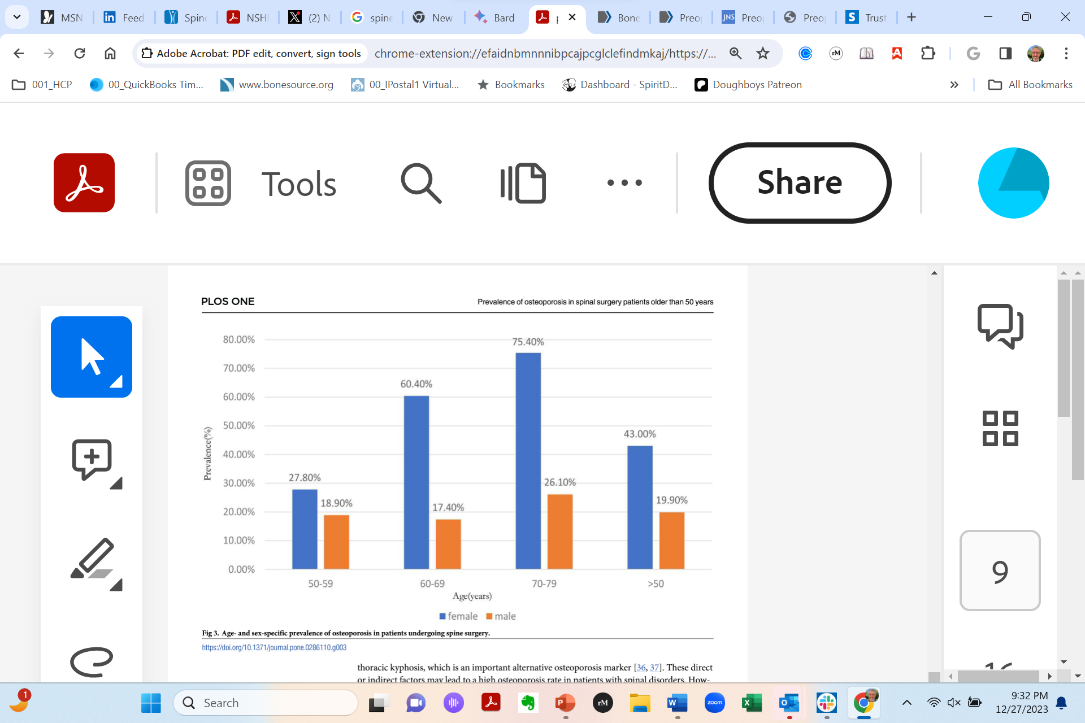
Spine Health Optimization: Connecting Spine and Bone Health for Better Surgical Outcomes
All adult patients undergoing spinal instrumented surgery should have their bone density assessed pre-operatively
Optimizing spine health before surgery is a crucial step for improving patient outcomes and reducing complications
NSHF is educating spine surgeons and non-surgeons to improve bone health and increase patient outcomes
Age- and sex-specific prevalence of osteoporosis in patients undergoing spine surgery (per meta-analysis)¹
¹PLoS One. 2023; 18(5): e0286110 (https://www.ncbi.nlm.nih.gov/pmc/articles/PMC10212156/)

Slide 7

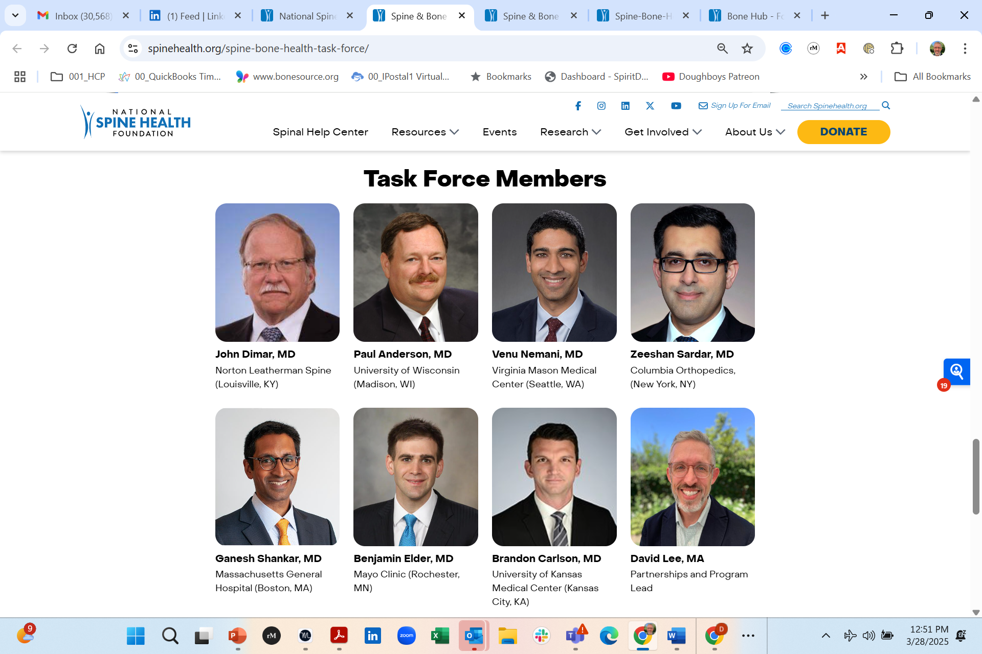
NSHF Spine & Bone Health Task Force
NSHF’s Spine & Bone Health Task Force is focused on steering NSHF’s strategic activities around spine and bone health.
A central focus of our Task Force activities:
spine and bone health patient and health professional education
Improve patient outcomes regarding the diagnosis and treatment of osteoporosis (as it relates to spine surgery)

Slide 8
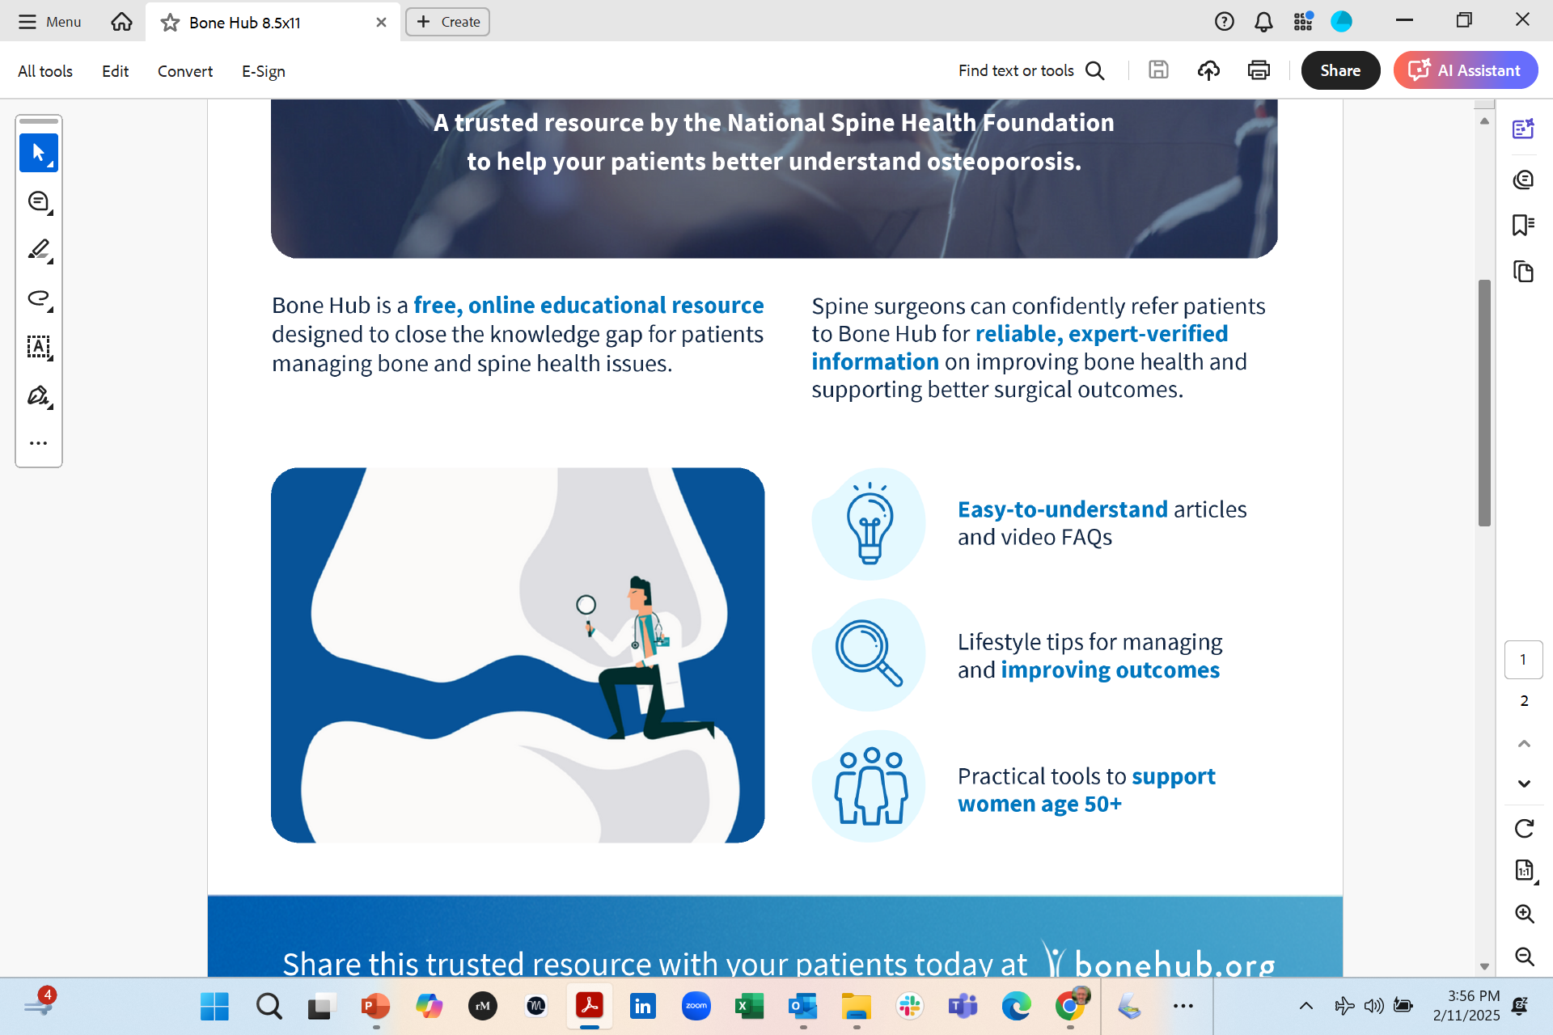
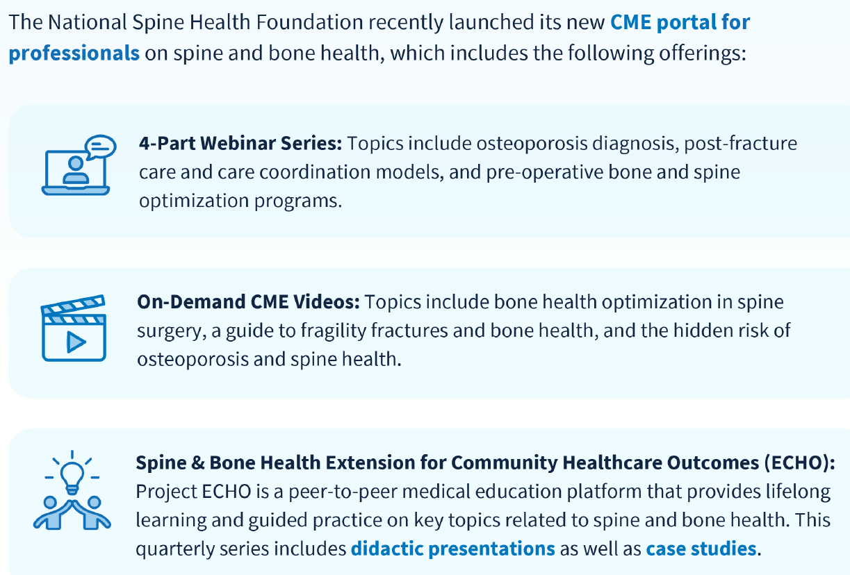
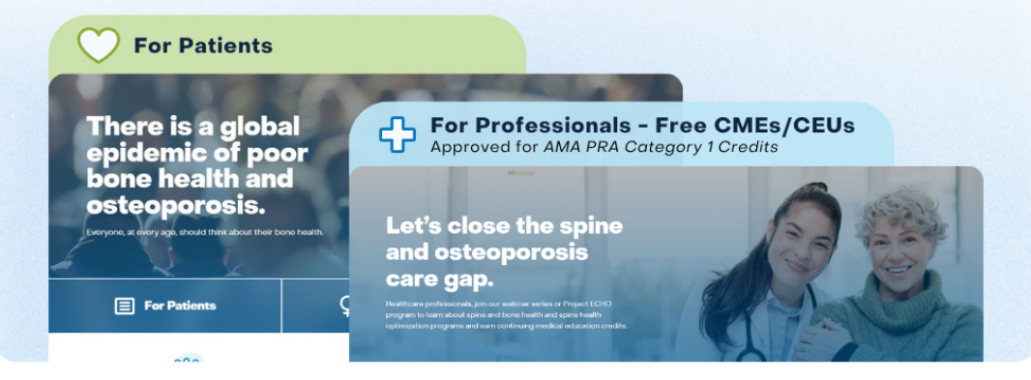
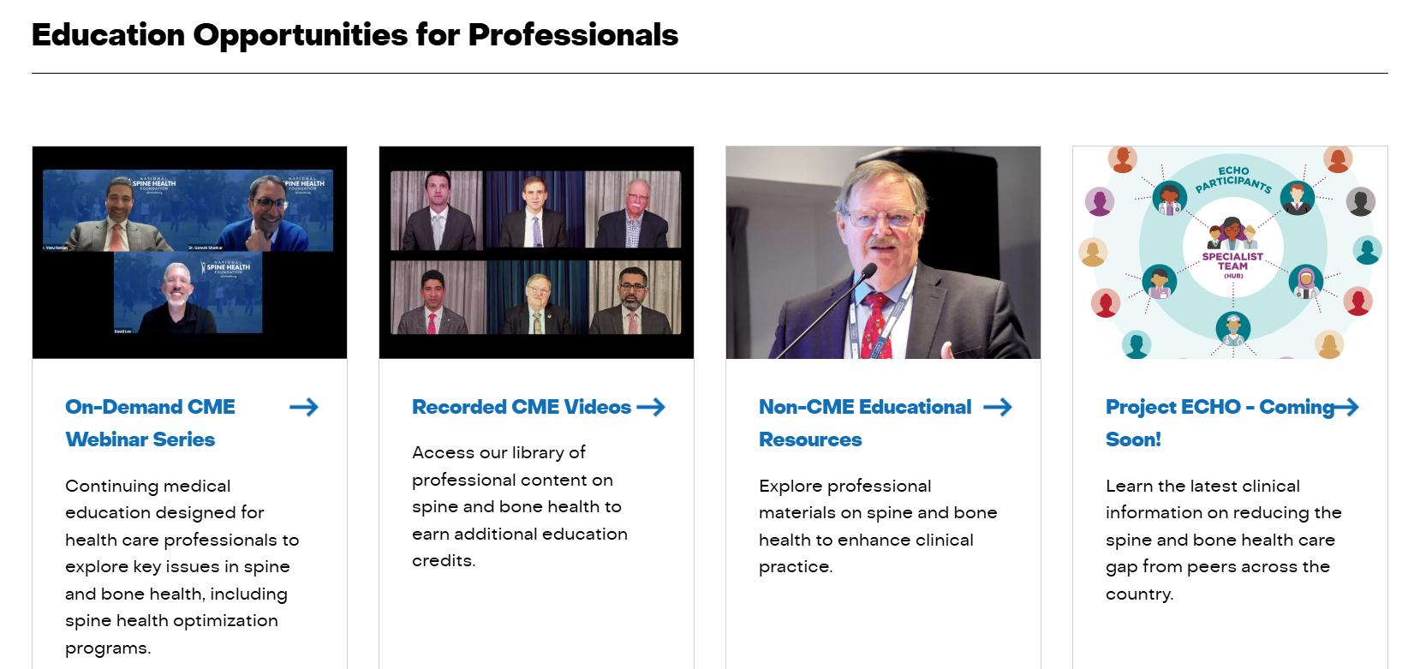
National Spine Health Foundation
Bone Hub
Patient and Professional Spine and Bone Health Content
www.bonehub.org
cme.spinehealth.org

Slide 9
NSHF Spine and Bone Health Patient Survey (Using Results to Identify Knowledge Gaps)
NSHF conducted a 10 question online survey on spine and bone health in Q4 2024 which received a total of 1,440 responses; results:
Overall, 56.6% of respondents achieved quiz scores of 80% or above
    Over 90% across all age groups correctly recognized that bones weaken with age, while awareness of osteoporosis medications increased with age
    Among respondents diagnosed with a spine condition:
    55.2% achieved a quiz score of 80% or better
    52.4% reported having had a bone density test, compared to 31.7% of those without a spine condition
    Interest in learning about bone health treatments was significantly higher among respondents with spine conditions (78.1%) than those without
In respondents with history of spine surgery:
15.9% reported prior bone health evaluation
84.0% expressed interest in learning about treatment options
Most respondents (70.6%) indicated interest in improving or restoring bone health

Slide 10
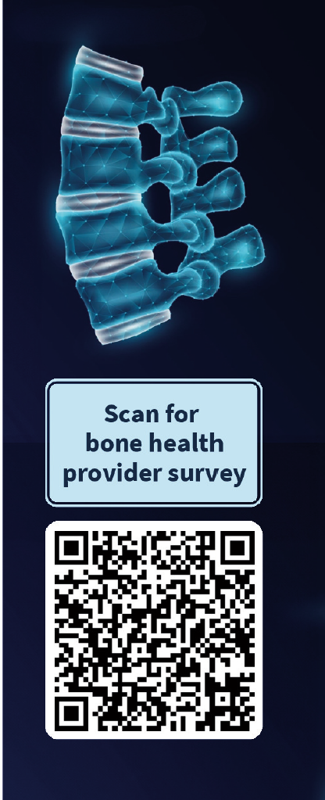
Spine Surgeon Survey
Improving Bone Health Assessment
With rising osteoporosis and increasing spine surgeries assessing bone health before surgery is critical for optimal outcomes.
Survey Purpose
To understand US bone health assessment practices and challenges in optimizing care.
This activity is supported by an educational donation provided by Amgen.

Slide 11
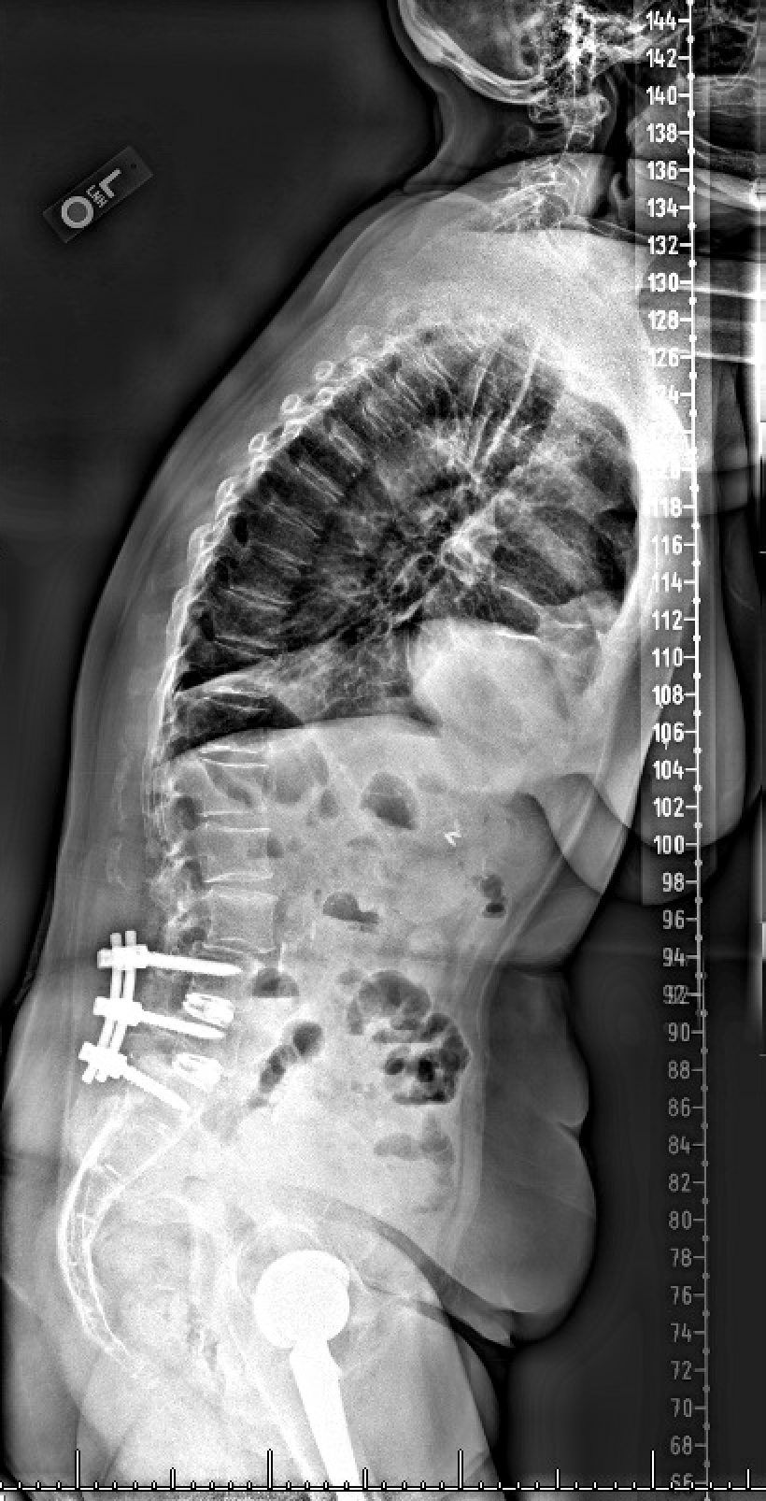
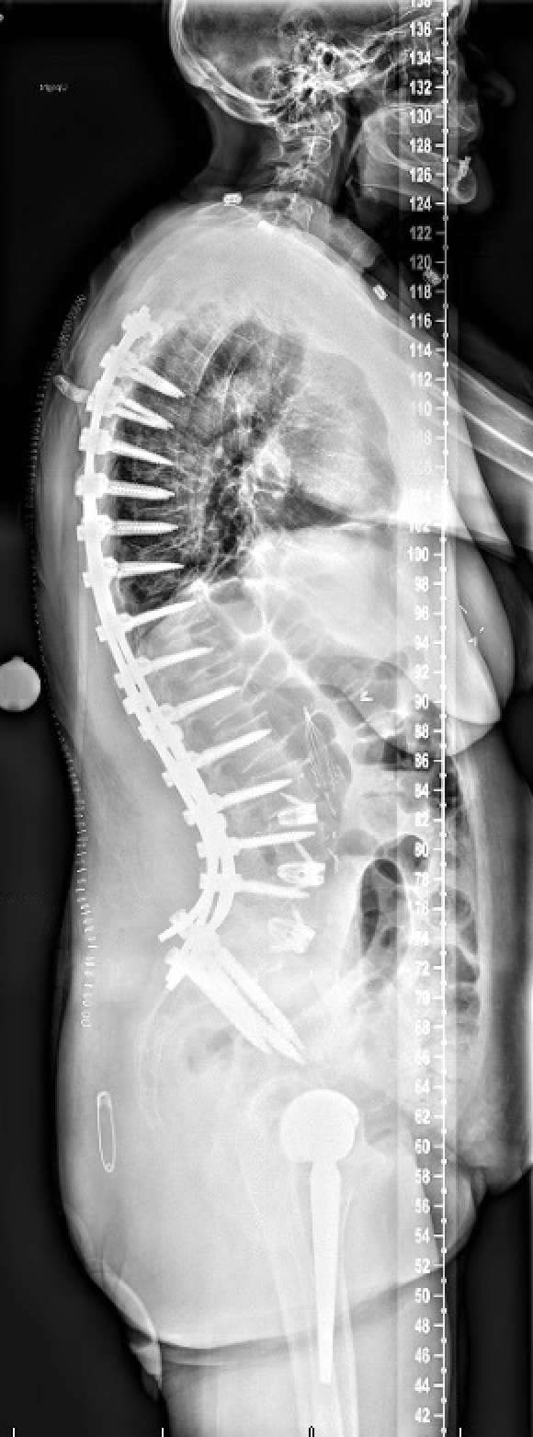

Bone Health Optimization in the Spine Surgery Patient
Venu M. Nemani, MD, PhD
Center for Neurosciences and Spine
Virginia Mason Medical Center
Seattle, WA USA
Global Spine Congress 2025
Rio de Janeiro, Brazil

Slide 12
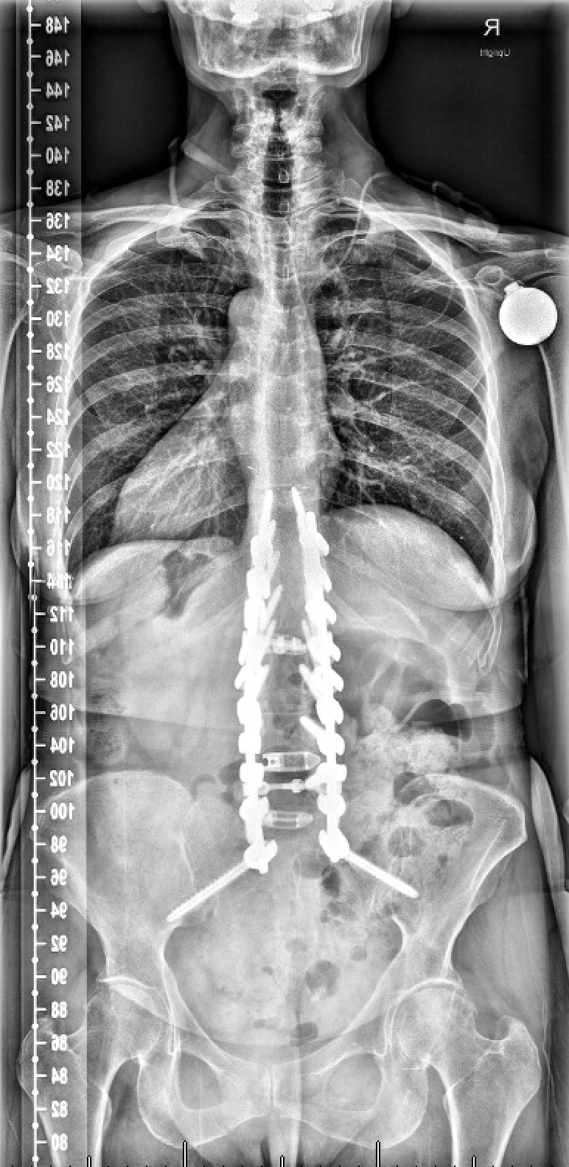
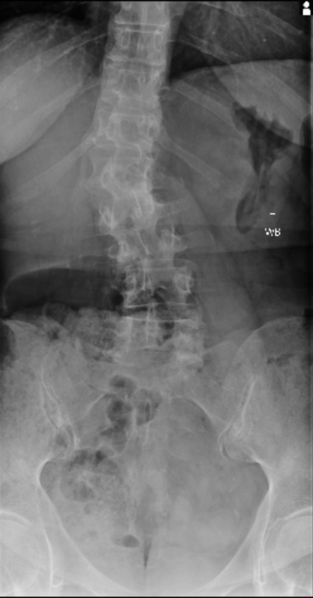
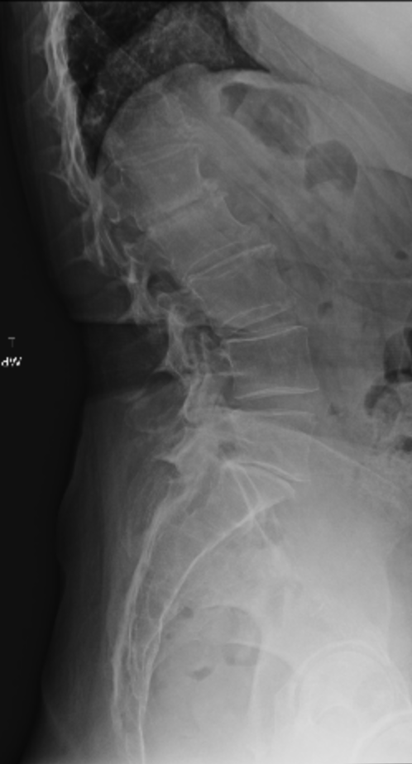
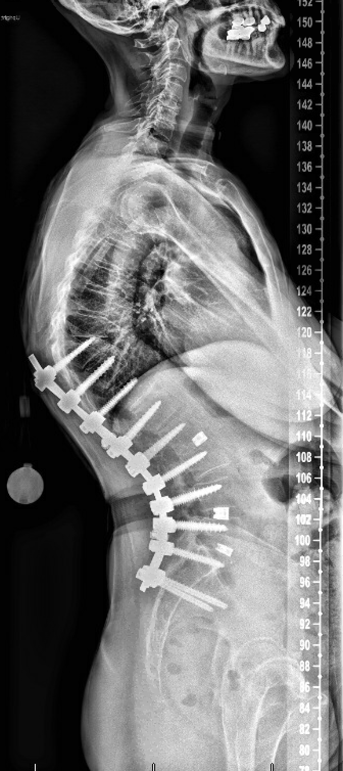
CASE EXAMPLE
72F who presented to another surgeon with back pain
Original presenting xrays show a minor scoliosis
Underwent a PSF T10-pelvis within 1 month of seeing him for the first time, and noticed an immediate prominence of instrumentation even before hospital discharge
Told by her surgeon that “everything looked fine”

Slide 13
CASE EXAMPLE
Now presents to me with difficulty standing upright and severe back pain
No myelopathy symptoms and no neurological deficits
Does this patient need an evaluation of her bone health?
If so, how to best initiate this and take her through the optimization process?

Slide 14
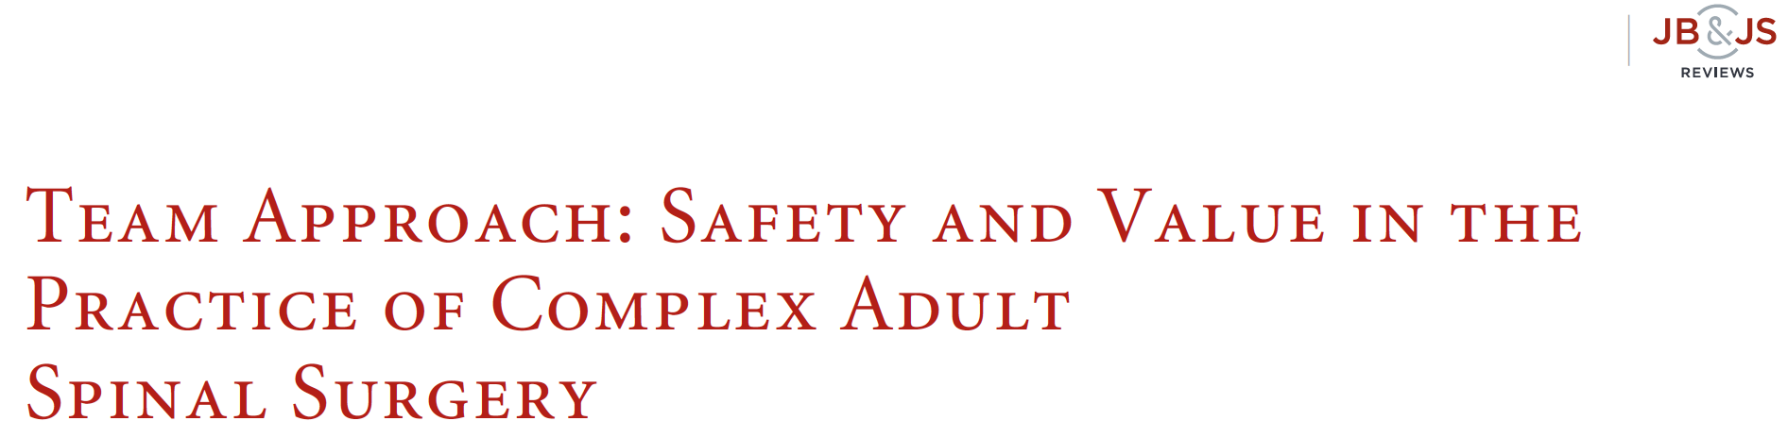
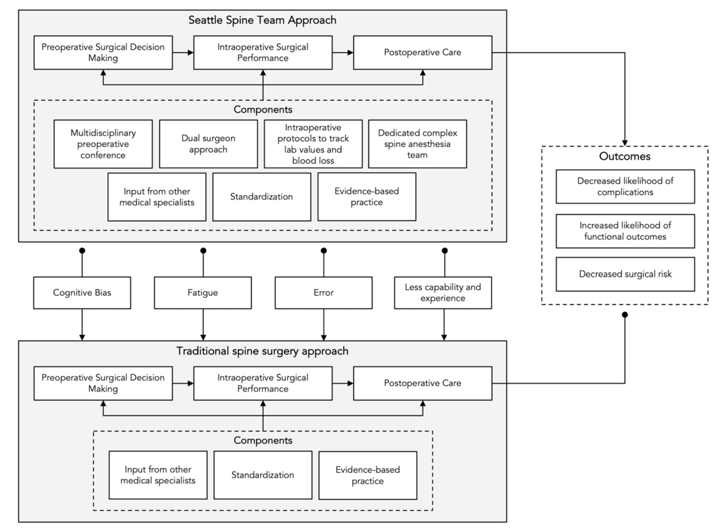
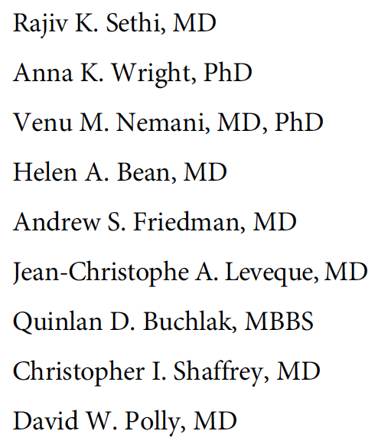
BONE HEALTH SCREENING
AND OPTIMIZATION!!

Slide 15
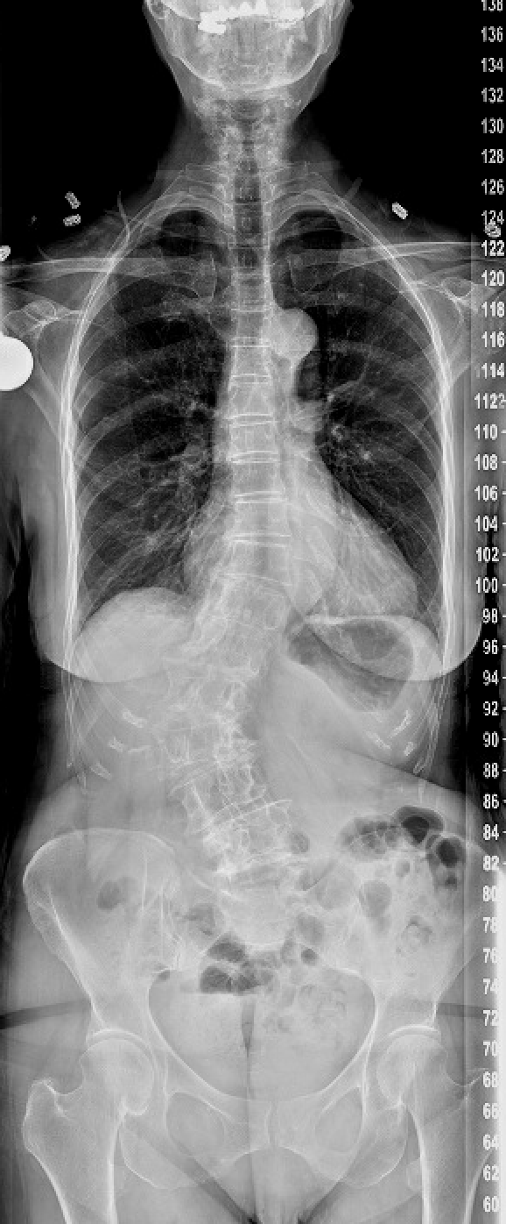
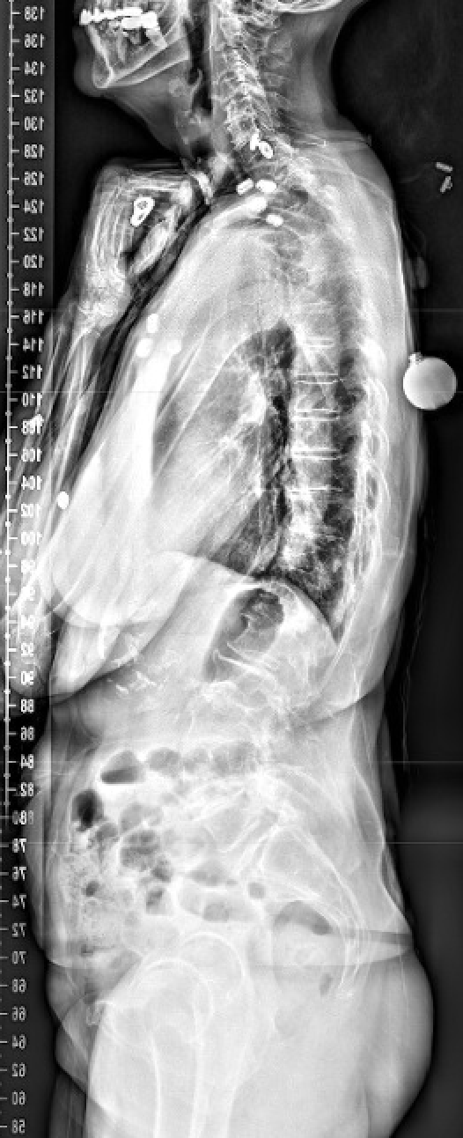
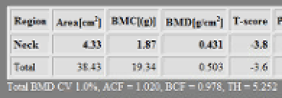
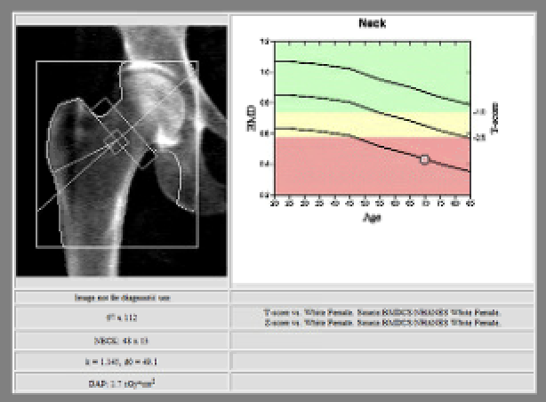
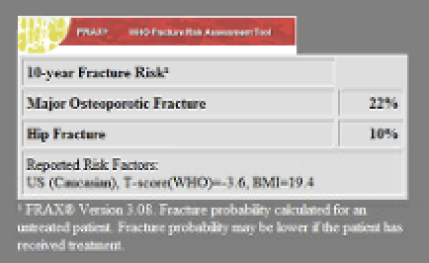
Why Is It Important for Spine Surgeons to Understand Bone Health?
Any spinal fusion procedure relies on secure fixation to promote successful healing in appropriate alignment
20% of all patients and 50% of women over the age of 50 who were being considered for spine surgery had osteoporosis
We are often one of the first to see spinal fracture patients and thus have a duty to guide patients on the right path!
Wagner, S. C., et al. (2016). Spine, 41(21)

Slide 16
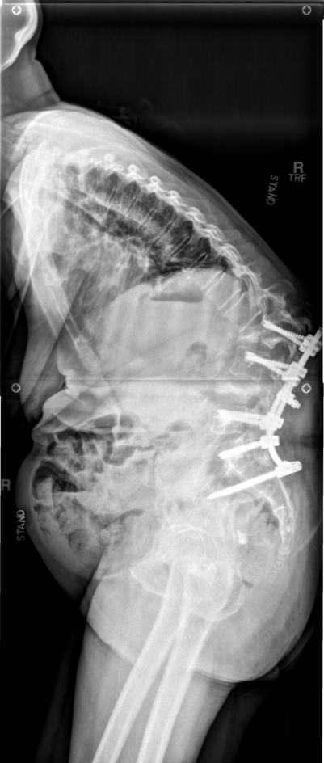
Why You Should Screen For Poor Bone Health!
Increased risk of complications – some of which are catastrophic!
- pseudarthrosis
- screw loosening
- rod fracture
- cage subsidence
- proximal junctional failure
- spinal cord injury / myelopathy
- sacral fractures
NEED FOR REOPERATION, INCREASED COST, POOR OUTCOMES
Primary care doctors / general practitioners will often not do it!

Slide 17
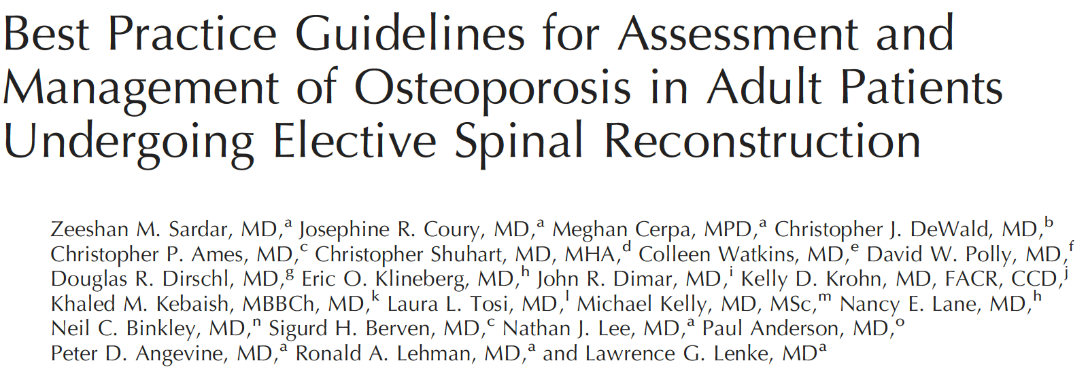
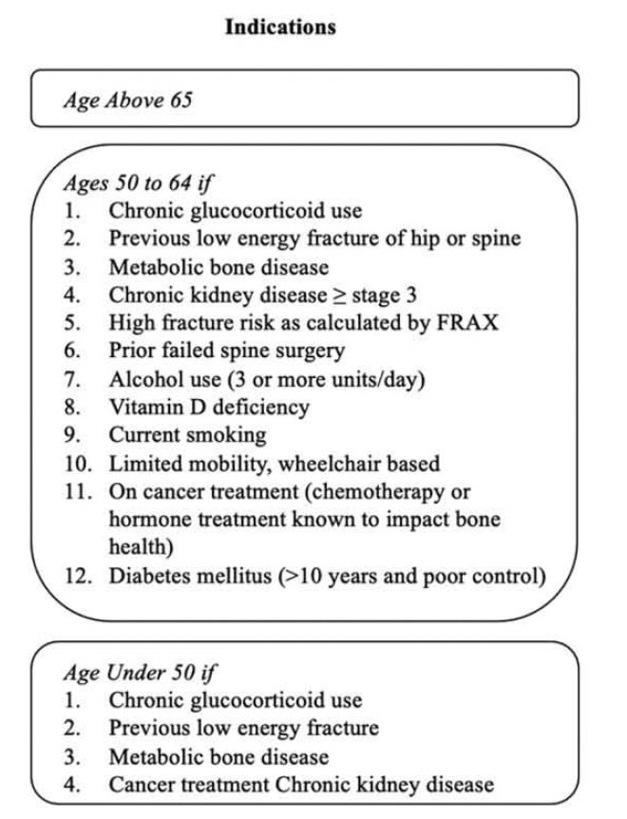
WHO AND HOW TO SCREEN FOR POOR BONE HEALTH?
Bottom Line
- Screen everyone > age 65
- Screen those < age 65 with risk factors (or if you’re suspicious)
- Mainstay is DXA scan

Slide 18
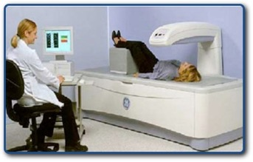
DXA Scan
Gold standard for bone density testing
Hip, spine, distal radius (get all of them)
Spine DXA often not helpful in spine surgery patients (falsely elevated)
Classification | T-Score
Normal | -1.0 or greater
Osteopenia (Low Bone Mass) | Between -1.0 and -2.5
Osteoporosis | -2.5 and below
Severe Osteoporosis | -2.5 and below and a fragility fracture

Slide 19
WHO AND HOW TO SCREEN FOR POOR BONE HEALTH?
Falls
Geometry
Micro-architecture
Risk
Factors
Mineralization
Fracture
Risk
BMD
Fracture history
Slide courtesy of Paul Anderson

Slide 20
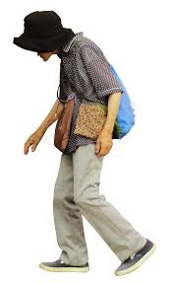
DXA Should Not Be Used In Isolation!
50% of fractures occur in patients whose T score is > -2.5!
Other modalities:
  - Patient history & risk factors
      - trabecular bone score
      - qCT
      - VBQ (MRI based)
      - CT Hounsfield units

Slide 21
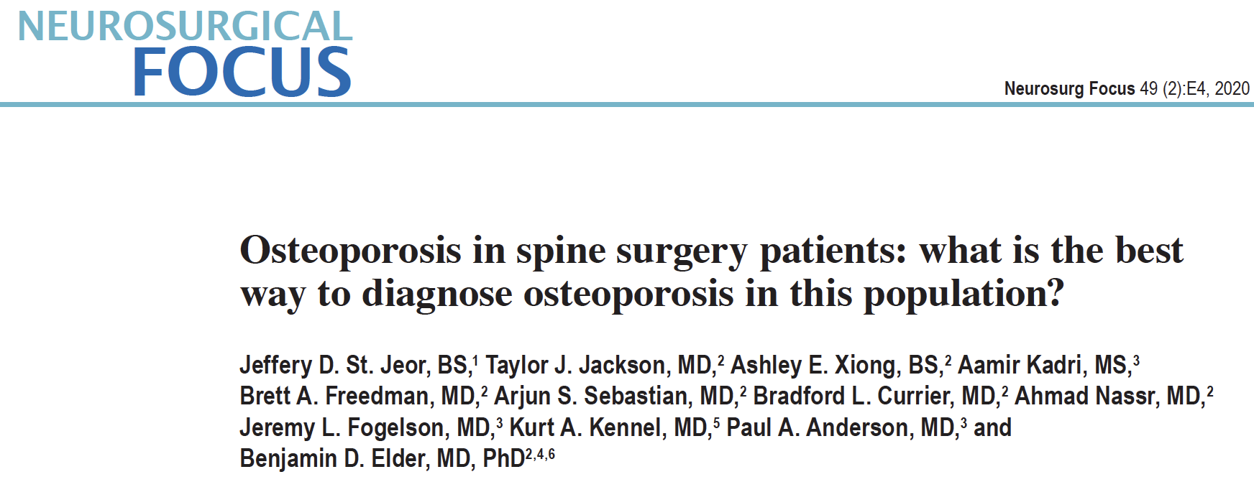
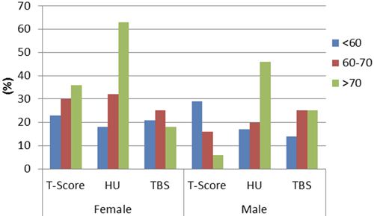
Retrospective review of 244 spine patients from 2 academic centers
Patients had:
DEXA, CT (HU), TBS, FRAX
Osteoporosis determined using 4 criteria:
WHO (T-score < -2.5 (25.4%)
CT HU of < 110 (36.5%)
NBHA guidelines (75%)
  a) T-score ≤ −2.5 or
  b) history of low-energy fracture or
  c) FRAX ≥3% (hip) or ≥20% (MOF) 10-yr fracture risk
Expanded guidelines (NBHA and or HU<110 or degraded TBS in the setting of osteopenia on DEXA) (81.9%)
(Age)
osteoporosis
Slide courtesy of Ben Elder

Slide 22
CASE EXAMPLE
DEXA
Femoral neck T-score -2.8
Normal T-score > -1.0
Osteopenia -1.0 > T-score > -2.5
Osteoporosis T-score < -2.5
→ What if her T-score was -2.3??
Clues in this patient:
- Thin (BMI 20)
- Older Caucasian female
- What else can we use?

Slide 23
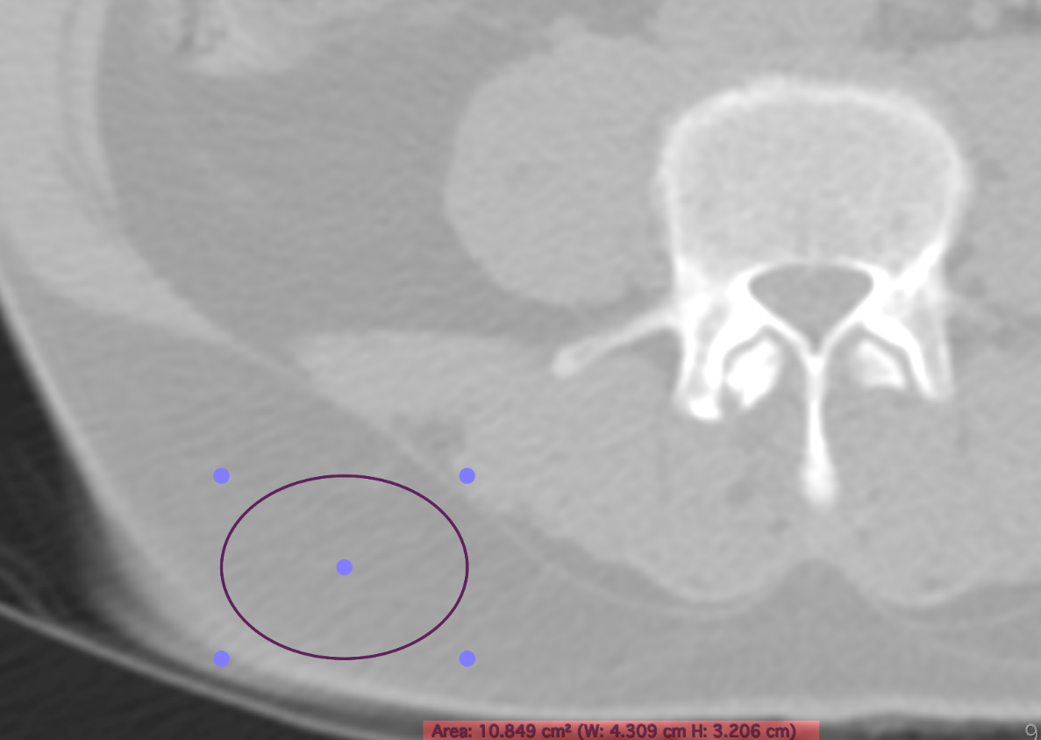
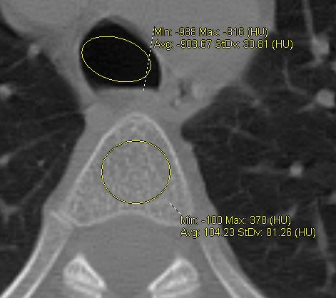
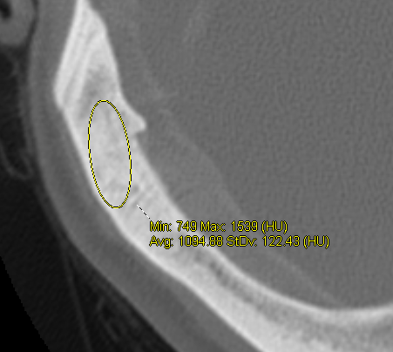
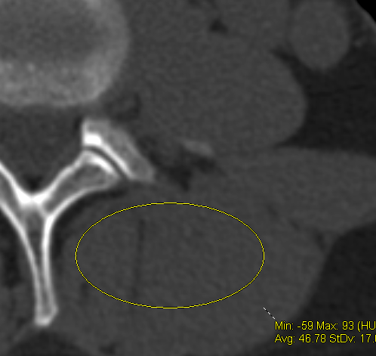
CT Hounsfield Units (HU)
Fat - 89
Air - 908
Cancellous - 106
Cortical Bone -1095
Muscle - 46
Slide courtesy of John Dimar

Slide 24
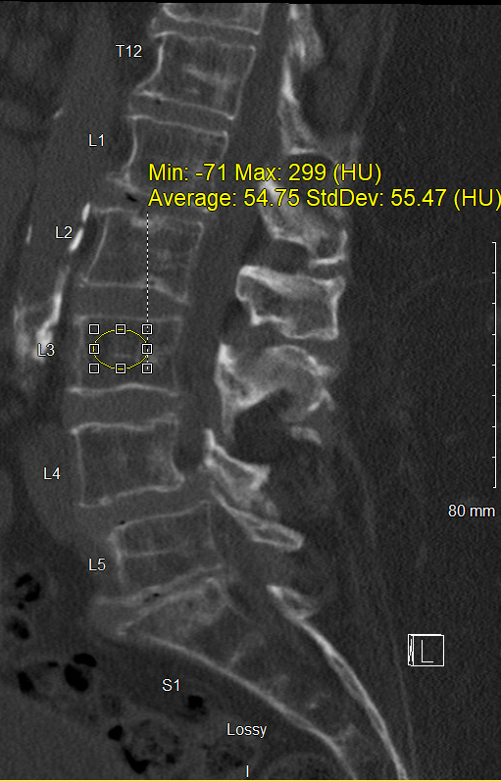
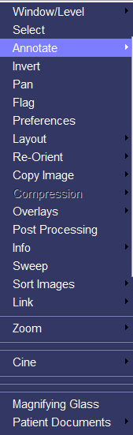
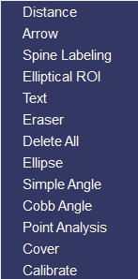
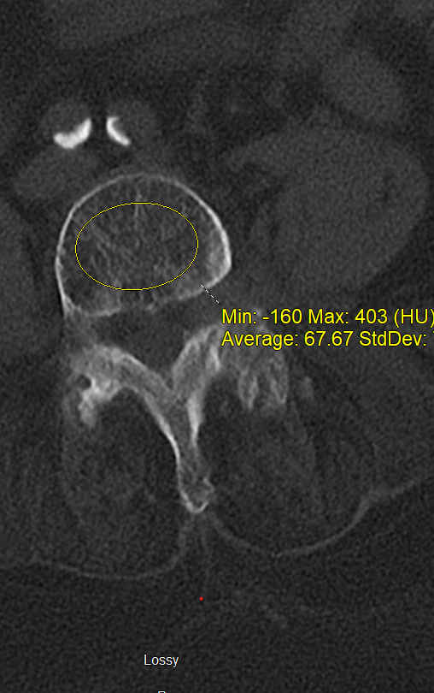
CT Hounsfield Units – How Do You Measure Them?
Slide courtesy of John Dimar

Slide 25
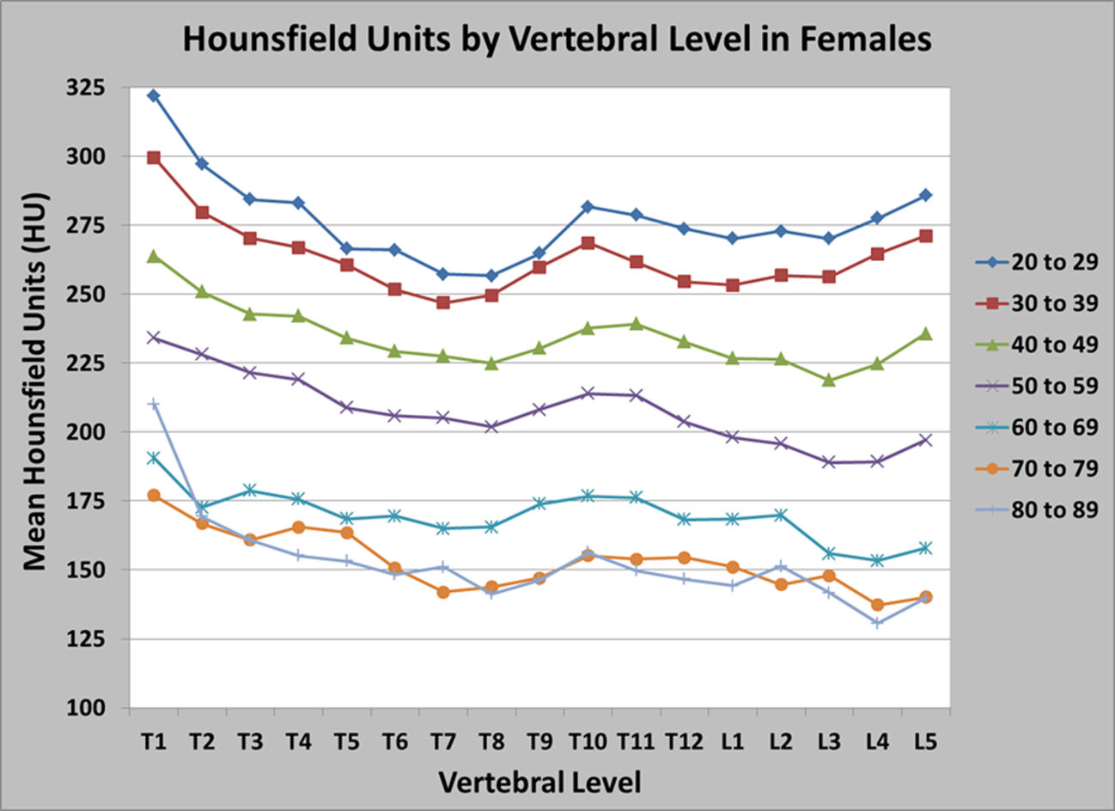
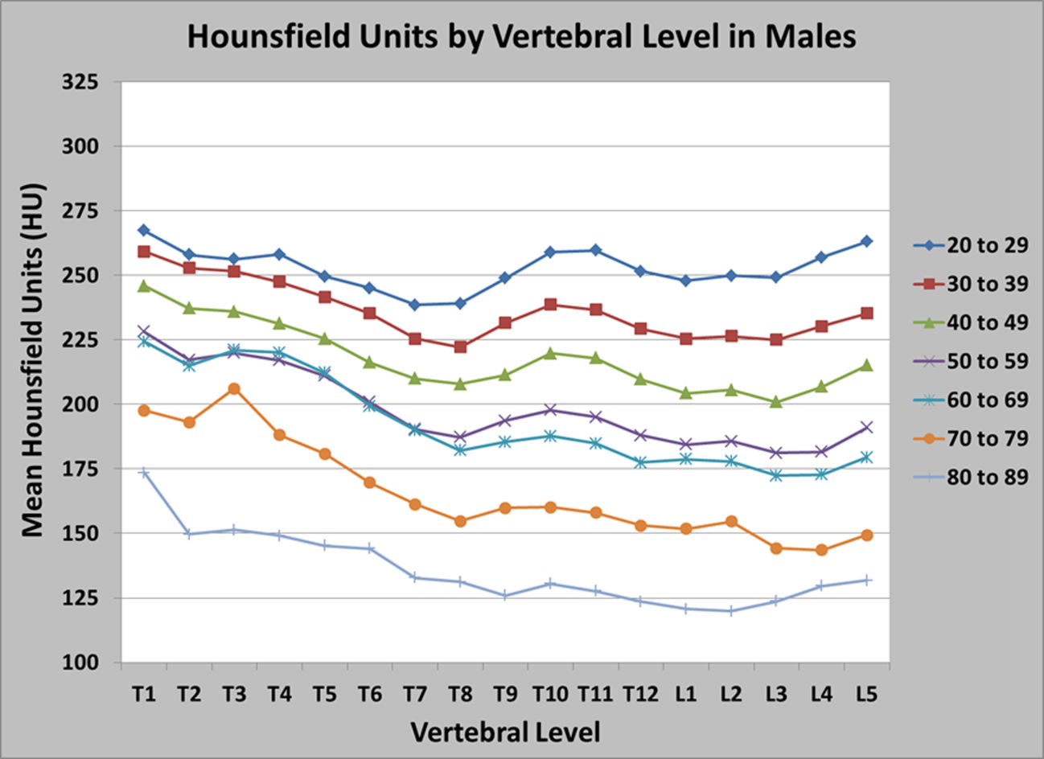
Adults
What are normal CT HU?
Aged Averaged HU - Per Level /Sex
Mean & 95% Confidence in Normal, Osteopenia, & Osteoporotic Patients |  | Equivalent CT-Hounsfield Units
 |  | DEXA Automated Reports |  | DEXA Radiology Reports
Classification | T - Score | Mean ± SD | 95% CI | Mean ± SD | 95% CI
Normal | Greater than -1.0 | 195.7± 55.5 | 171-220 | 189±59 | 160-219
Osteopenia | Between -1.0 & -2.5 | 118.9 ± 29.1 | 99-139 | 149±49 | 109-170
Osteoporosis | Less than -2.5 | 97.9 ± 58.8 | 54-142 | 107±60 | 65-149
Notes: Values of P , 0.001 Between Automatic Groups & P < 0.01 Between Radiology Groups. DEXA, Dual X-ray Absorptiometry
Slide courtesy of John Dimar

Slide 26
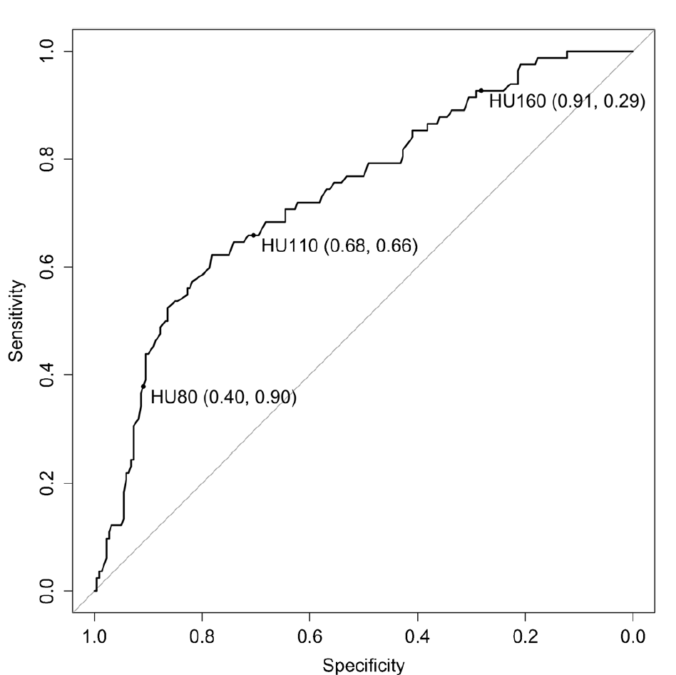
CT Hounsfield Units (HU) - Cutoffs
< 110 Osteoporosis
110-150 Osteopenia
> 150 Normal
 | Studies | Threshold
Pedicle Screw Loosening | 7 | 110
Cage Subsidence | 3 | 120
Sagittal Imbalance | 1 | 100
Proximal Junction Kyphosis | 6 | 120
Pseudoarthrosis | 1 | 107
Secondary Fracture | 1 | 110
Pickhard JBMR 2011
Lee Clin Rev Bone Min metab 2018
Alacreu OI 2017
Buchens EuRad 2015
Slide courtesy of John Dimar

Slide 27
CASE EXAMPLE
Remember – Osteoporosis Can Be Diagnosed Multiple Other Ways Even if T Score is > -2.5
- FRAX score 10 yr hip fx risk > 3% or MOF risk > 20%
- Low energy (“fragility”) fractures
- Prescence of vertebral compression fractures on lateral xray
CT HU at T9 = 108

Slide 28
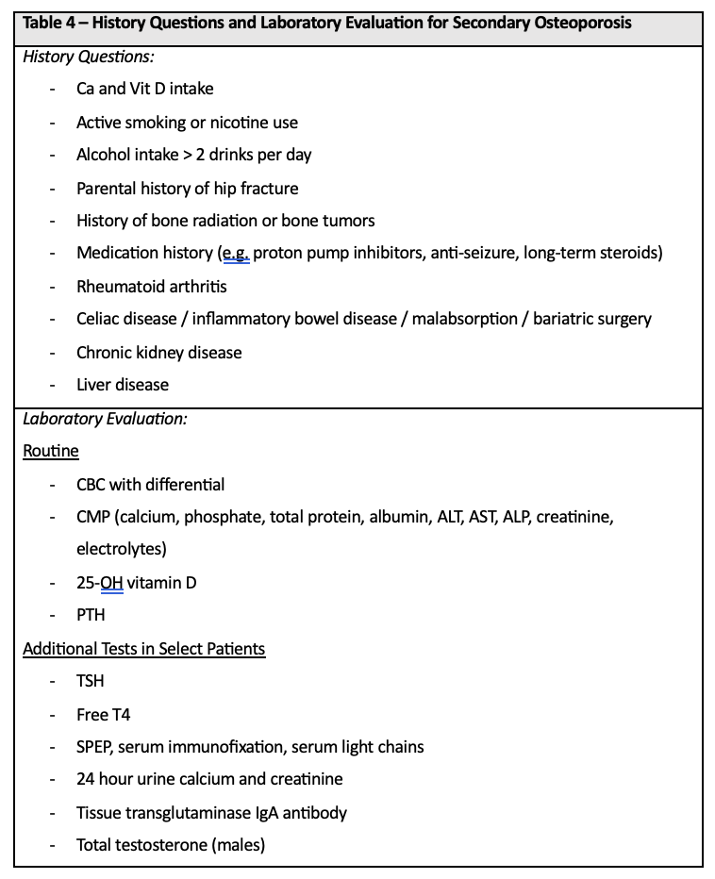
Next Step - Bone Health Assessment (History / Labs)
Calcium 1500mg / day
Vit D3 1000 IU / day
Goal 25-OH vit D level > 30 ng/mL
Optimize modifiable risk factors ASAP!!
Nemani et al, manuscript under review

Slide 29
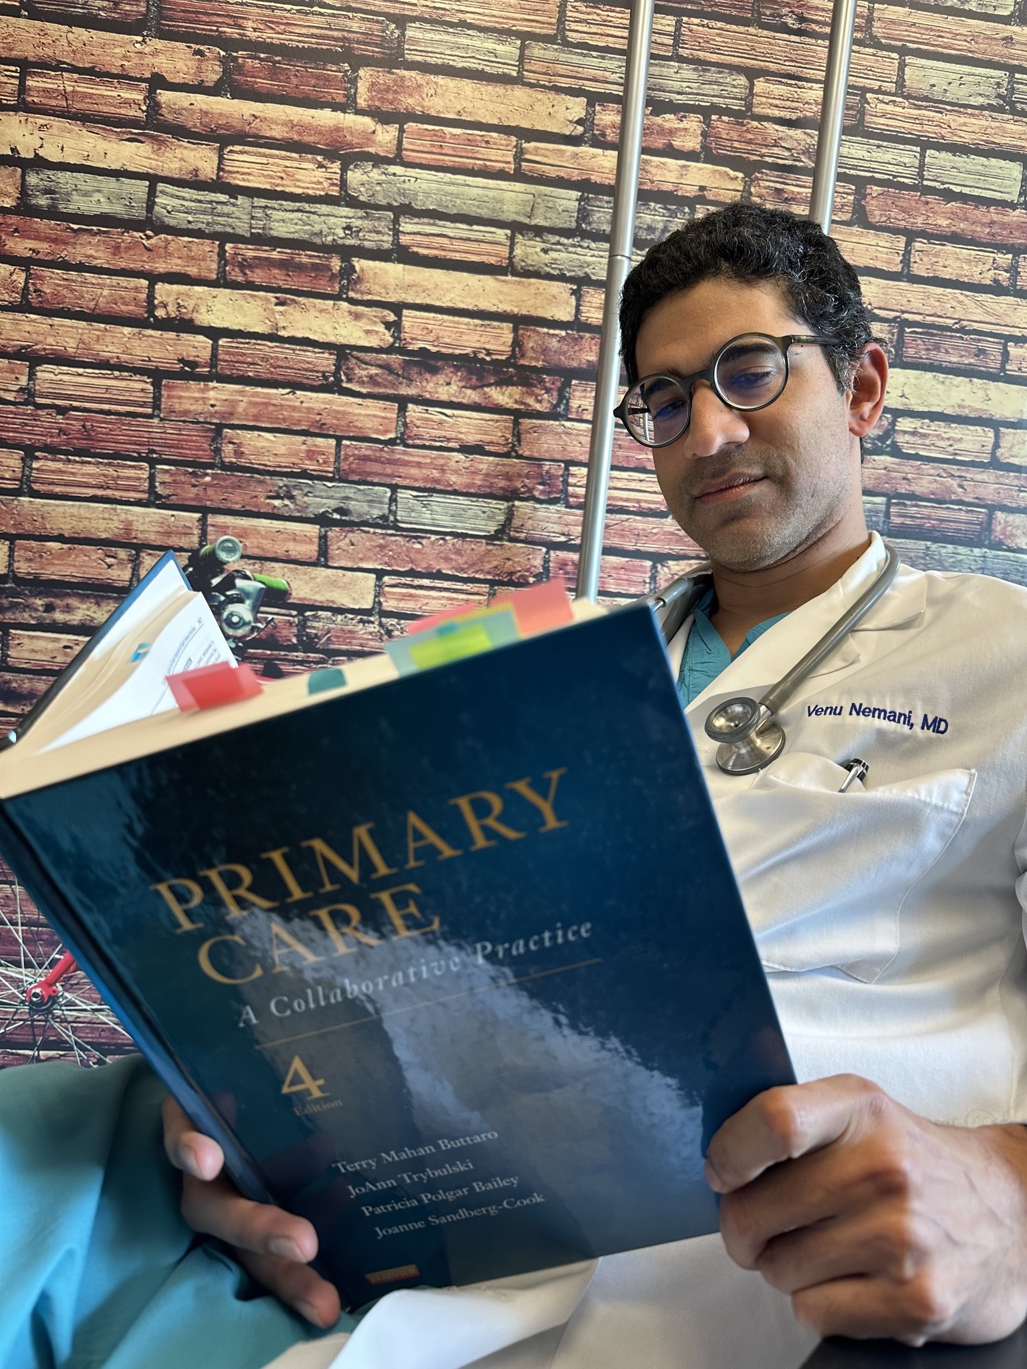
What Next?
Treatment of osteoporosis prior to spine surgery
- improves outcomes
- reduces complications
Options
Refer to endocrinology/PCP
In house bone health program
Bone health optimization program embedded within your department (best)
Treat yourself

Slide 30
PHARMACOLOGICAL TREATMENT
Anti-Resorptives
Bisphosphonates
SERMs
Denosumab
Romosozumab
Calcitonin
Anabolics
Teriparatide
Abaloparatide
Romosozumab
Inhibit osteoclast function
Stimulate osteoblast function

Slide 31
PHARMACOLOGICAL TREATMENT
Anabolics should be 1st line (but are expensive, hard to get approved)
Treat at least 3-12 months before surgery and continue postop
Need to “seal in gains” with bisphosphonate after completion of therapy with an anabolic
Sequence of treatment matters (anabolics first, bisphosphonates second)
Choice is often dictated by insurance and medical factors

Slide 32
Bisphosphonates and Spine Fusion
 | Study design | Clinical results | Time to fusion | Fusion success | Hardware failure/fx
Nagahama | RCT | + | + | - | NR
Chen | RCT | + | + | + | +
Kim | RCT | - | - | - | -
Park | RCT | + | NR | + | NR
Tu | RCT | + | NR | + | ++
LI | RCT | - | NR | - | -
Bisphosphonates
Positive effect on bone healing
Improved clinical outcomes
Reduces bone related complications
Slide courtesy of Paul Anderson

Slide 33
Teriparatide and Spine Fusion
 | Study design | Clinical results | Time to fusion | Fusion success | Hardware failure/ fx
Ohtori | Cohort | NR | + | + | NR
Ohtori | Cohort | NR | NR | NR | +
Yagi | Cohort | NR | NR | NR | +
Ebata | RCT | - | + | + | -
Yolcu | Cohort | NR | NR | NR | +
Jespersen | RCT | NR | NR | - | NR
Miyazaki | Cohort | - | NR | + | -
Anabolic Agents
Positive effect on bone healing
Unchanged clinical outcomes
May reduces bone related complications
Slide courtesy of Paul Anderson

Slide 34
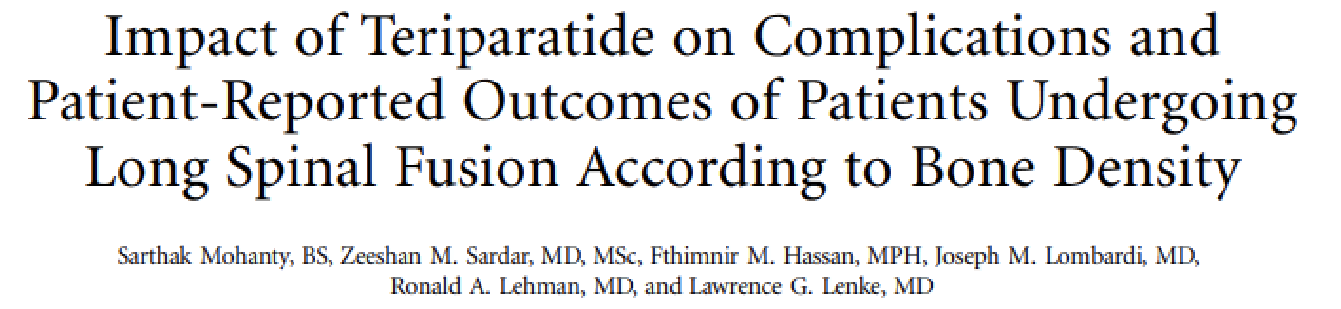
Single surgeon study
Compared normal BMD, osteopenic patients, and osteoporotic patients tx with teriparatide (6mo pre, 18mo post)
1º outcome = 2yr reoperation
Osteoporotic tx with teriparatide = normal BMD patients
% Complications
Slide courtesy of Paul Anderson

Slide 35
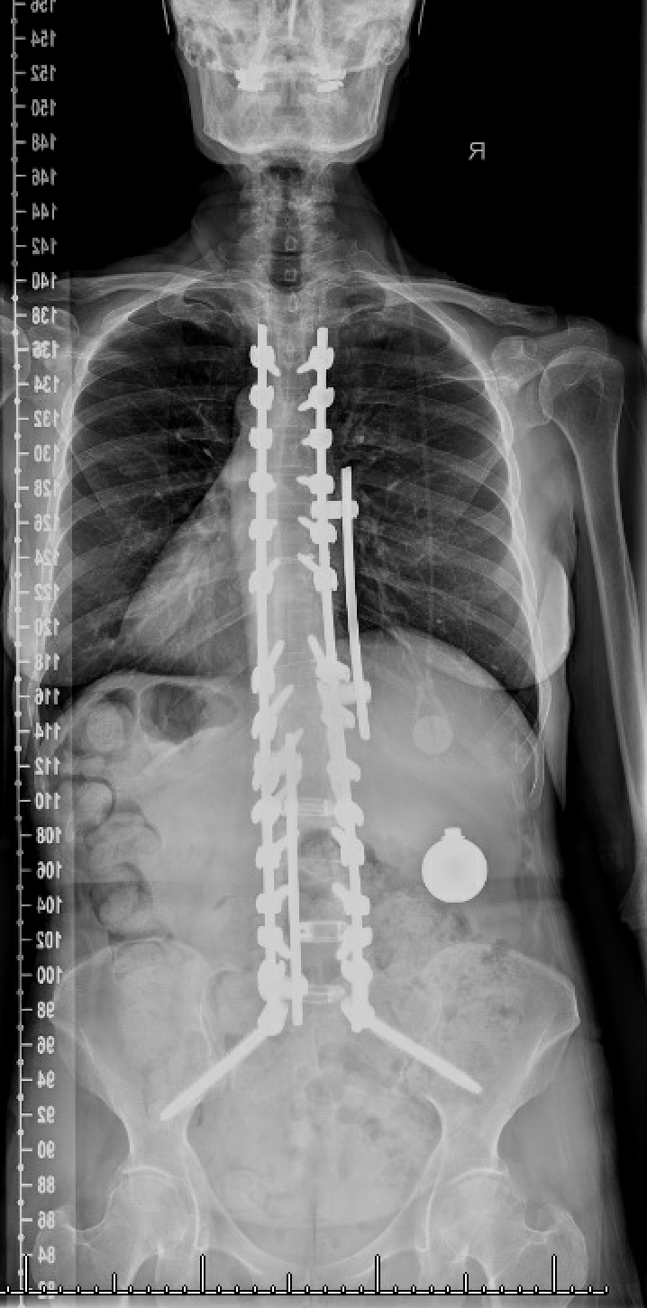
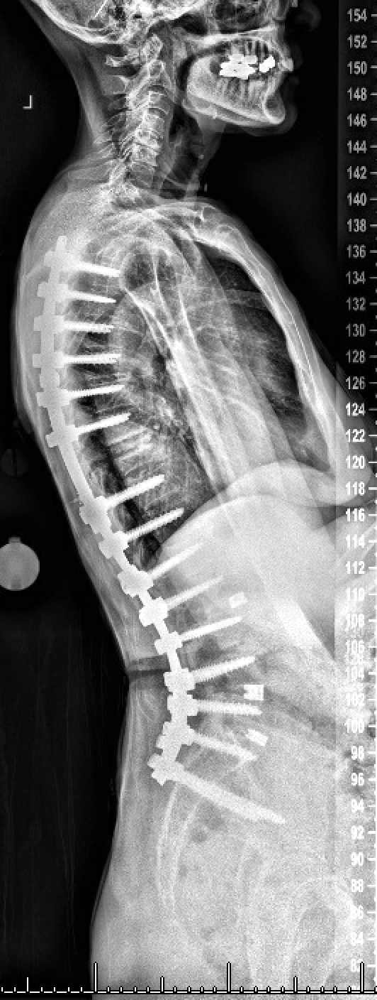
3 months of preop romosozumab treatment
Revision PSF T4-pelvis, VCR T10, ALL release T9-10, reverse PCO L3-4

Slide 36
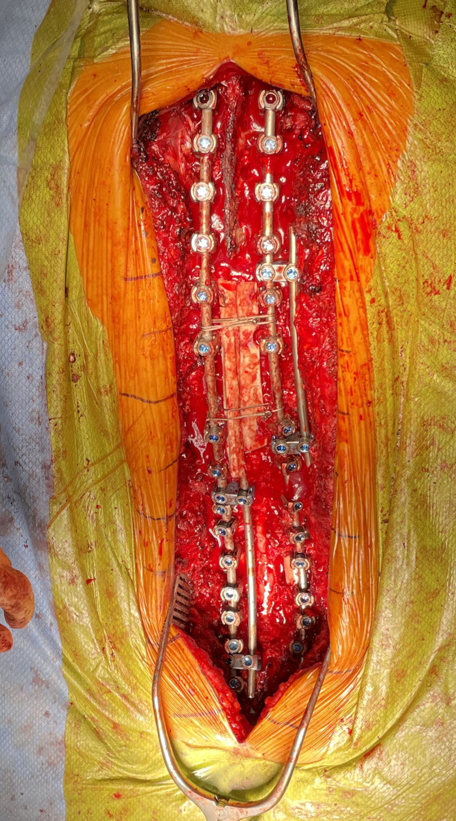

Reverse osteotomy (PCO) with fibular strut to maintain kyphotic correction

Slide 37
Preop parameters
PI = 43
L1-S1 lordosis = 65
L4-S1 lordosis = 32
PT = 23
L1PA = -1
T4PA = 2
Postop parameters
PI = 43
L1-S1 lordosis = 55
L4-S1 lordosis = 32
L1PA = 3
T4PA = 1

Slide 38
Summary
Have a high suspicion for bone health problems
Obtain labs and DEXA scans early
Start Ca and vit D supplementation early
Develop key partnerships with bone health specialists / endocrinologists who enjoy treating this patient population or setup an in-house program!

Slide 39
NSHF Contacts
Dr. Rita Roy
NSHF Chief Executive Officer
rroy@spinehealth.org
David Lee, MA
NSHF Partnerships and Program Lead, Spine and Bone Health
dlee@spinehealth.org

